Slide 1




Exploring discrepancies in viral production analyses
Hisham Shaikh
Maarten De Rijcke & Corina Brussaard

Slide 2
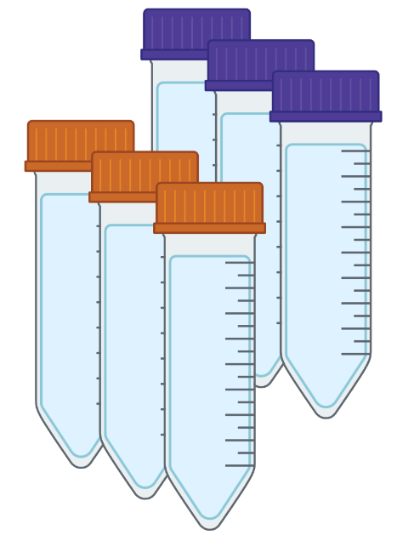
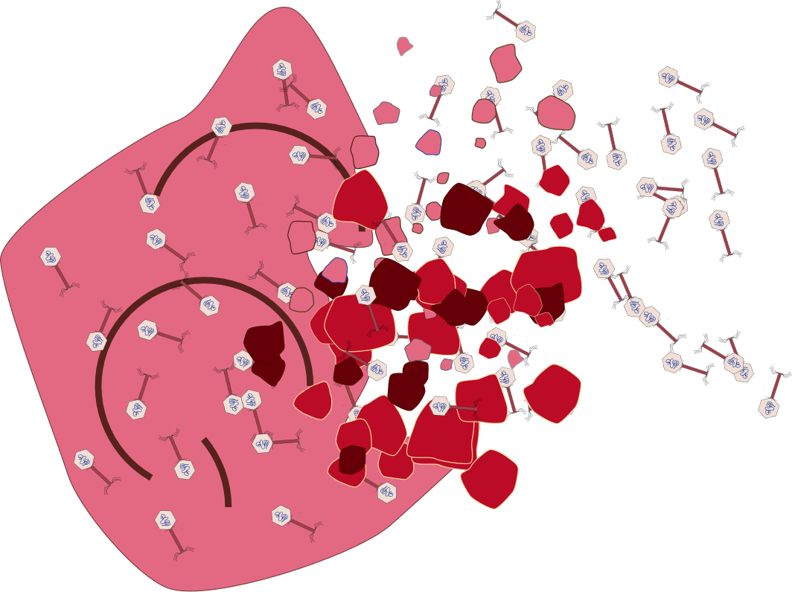
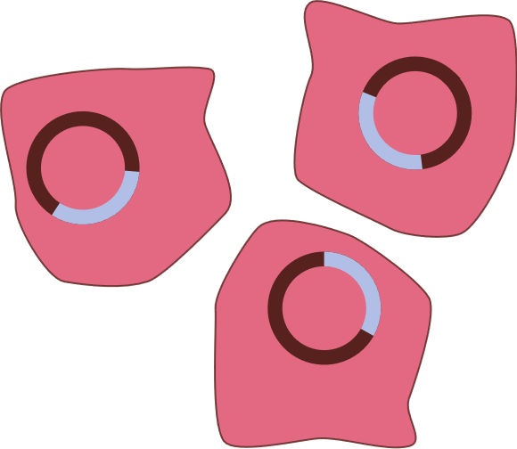
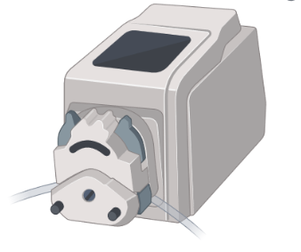
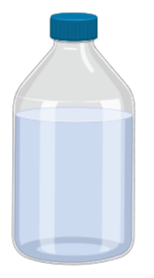
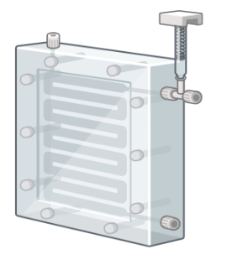
Virus Reduction Assay
Set Up
24-h Incubations
in dark
Why Mitomycin-C?
VPC
With
Mitomycin - C
Seawater
VP
Lytic
Lysogenic
VP = Lytic Viral Production
VPC = Lytic + Lysogenic Viral Production
Tangential flow filtration (0.22 µm)
Notes:
I started my PhD in late 2019.

Slide 3
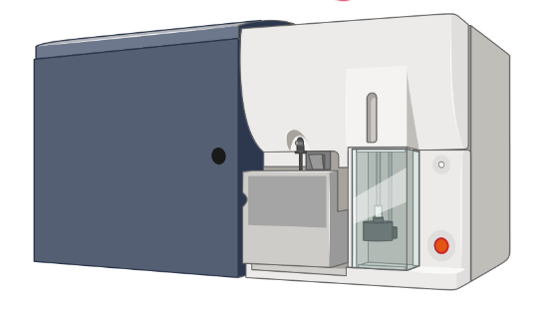
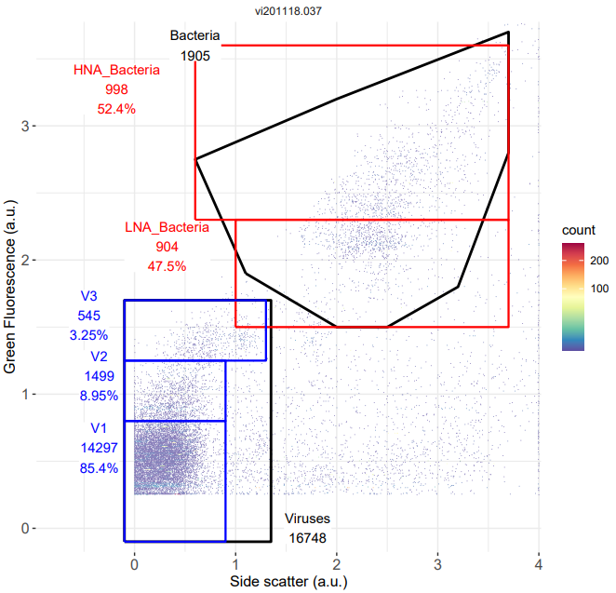
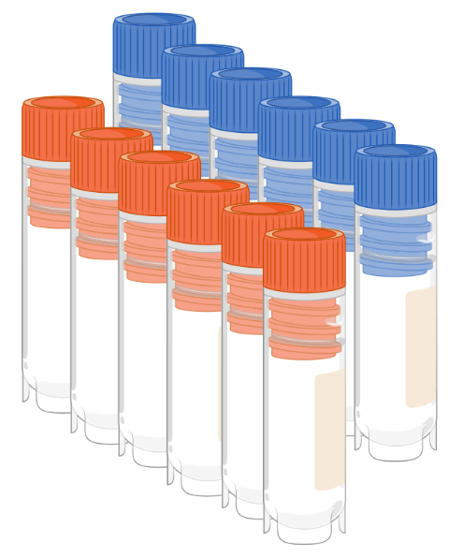
Virus Reduction Assay
Set Up
Flow Cytometer
24-h Incubations
in dark
VPC
With
Mitomycin - C
Seawater
VP
Subsampling:
T0, T3, T6, T9, T12, T24
Tangential flow filtration (0.22 µm)
Notes:
I started my PhD in late 2019.

Slide 4
Virus Reduction Assay
Lytic Viral Production
Virus Reduction Assay
Analyses
Linear Regression
VIPCAL
VP
Viral Count
Viral Count
Time
Time
Viral Production = VP_{slope}
Viral Production = Average of increments

Slide 5
Virus Reduction Assay
Lytic Viral Production
Analyses
Lytic + Lysogenic Viral Production
Lysogenic Viral Production
Linear Regression
VIPCAL
VP
VPC
Viral Count
Viral Count
Difference Curve
Time
Time
Lysogenic Production = VPC_{slope} - VP_{slope}
Lysogenic Production = Average of increments in Difference Curve
Negative viral production
Positive viral production

Slide 6
Virus Reduction Assay
Virus Reduction Assay
Analyses
Linear Regression
VIPCAL
Viral Count
Viral Count
Significantly different
Time
Time
Linear Regression
VIPCAL

Slide 7
Virus Reduction Assay
Lytic Viral Production
Lytic + Lysogenic Viral Production
Analyses
Linear Regression
VIPCAL
VP
VPC
Viral Count
Viral Count
Time
Time

Slide 8
Virus Reduction Assay
Linear Regression vs VIPCAL – Published Studies
Lack of standardization
Type
Increasing preference for VIPCAL
Lysogenic - Linear
No. of Studies published
Lysogenic - VIPCAL
Lytic - Linear
Lytic - VIPCAL
VIPCAL has its own issues
Year Published

Slide 9
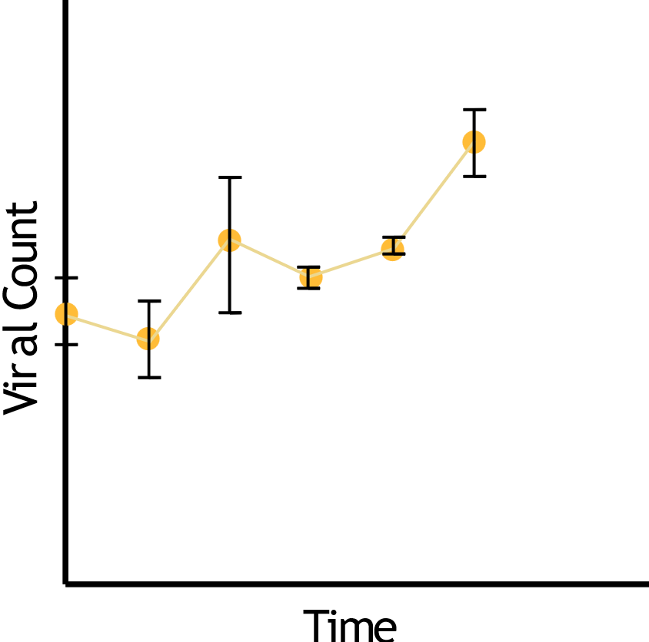
Virus Reduction Assay
Effect of Standard Error (SE) on VIPCAL
VIPCAL
VIPCAL-SE
Viral Count
Time

Slide 10
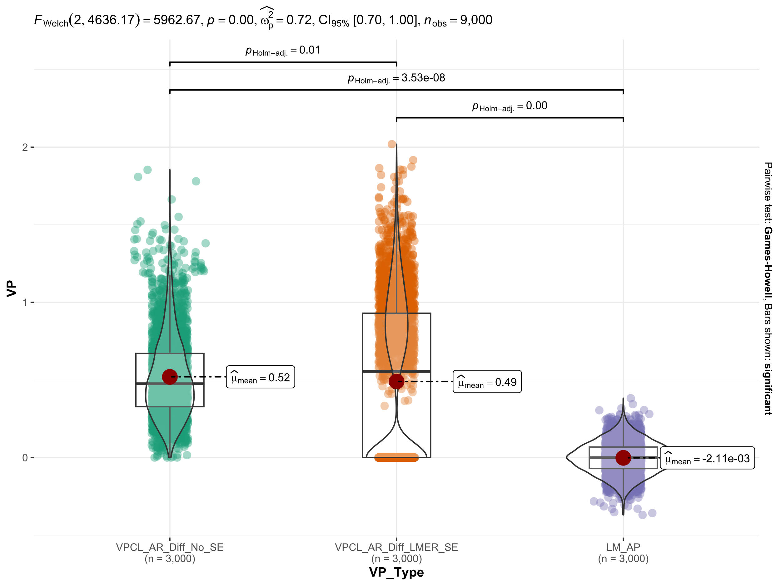
Virus Reduction Assay
Effect of Standard Error (SE) on VIPCAL
VIPCAL
VIPCAL-SE
Viral Count
Time
VIPCAL
VIPCAL -SE
LM

Slide 11
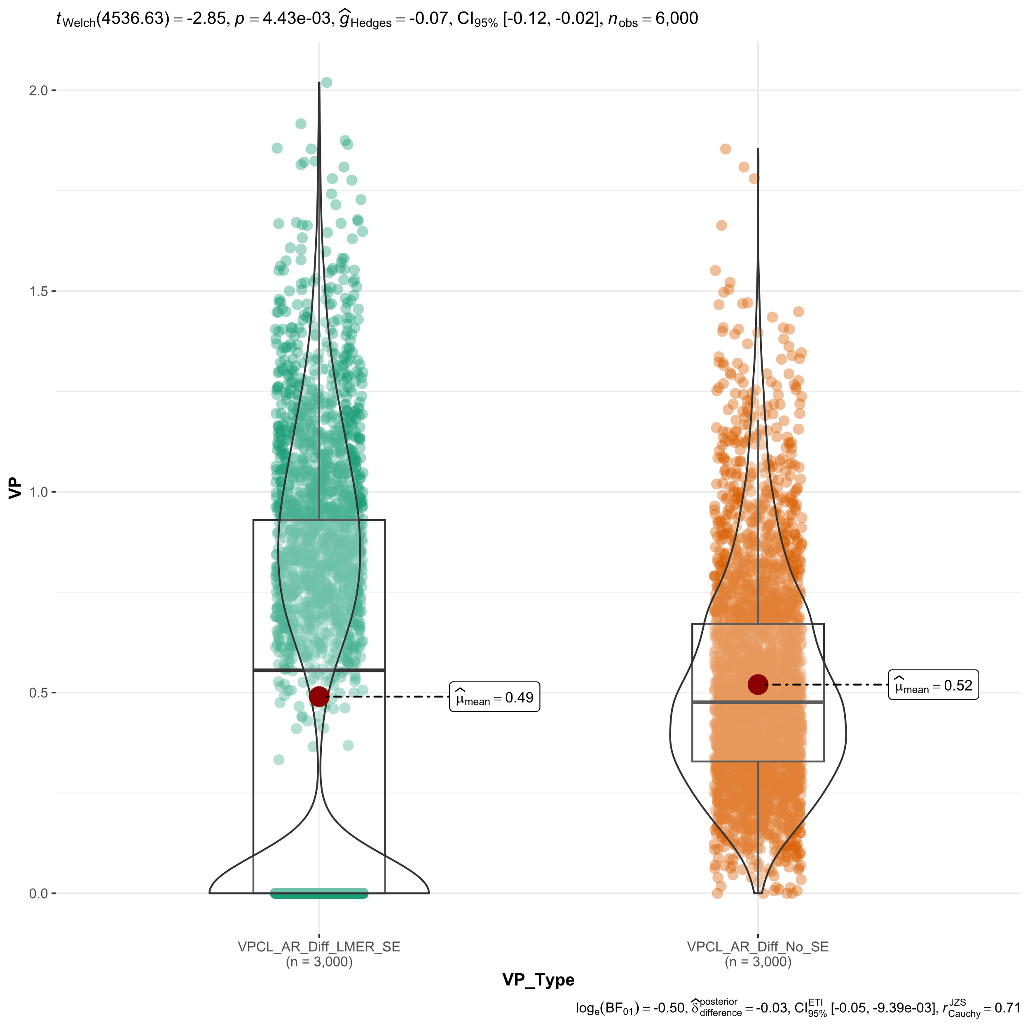
VIPCAL vs VIPCAL-SE Simulations
VIPCAL -SE
VIPCAL

Slide 12
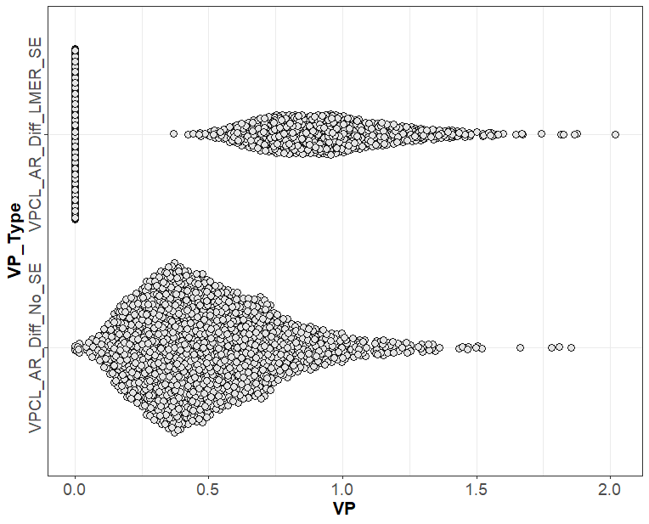

Robust Graphical Methods For Group Comparisons (ROGME)

Slide 13
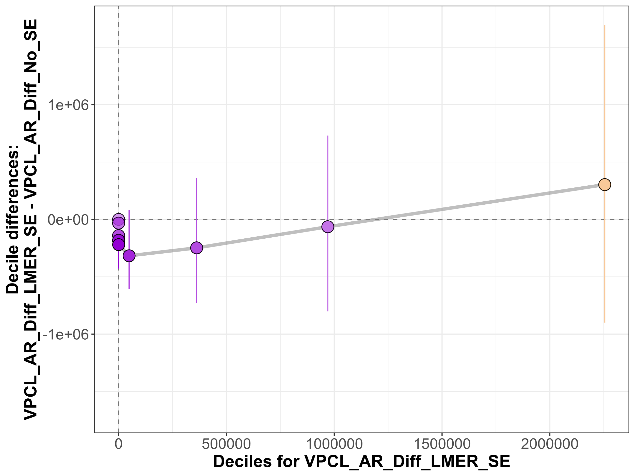
Robust Graphical Methods For Group Comparisons (ROGME)

Slide 14
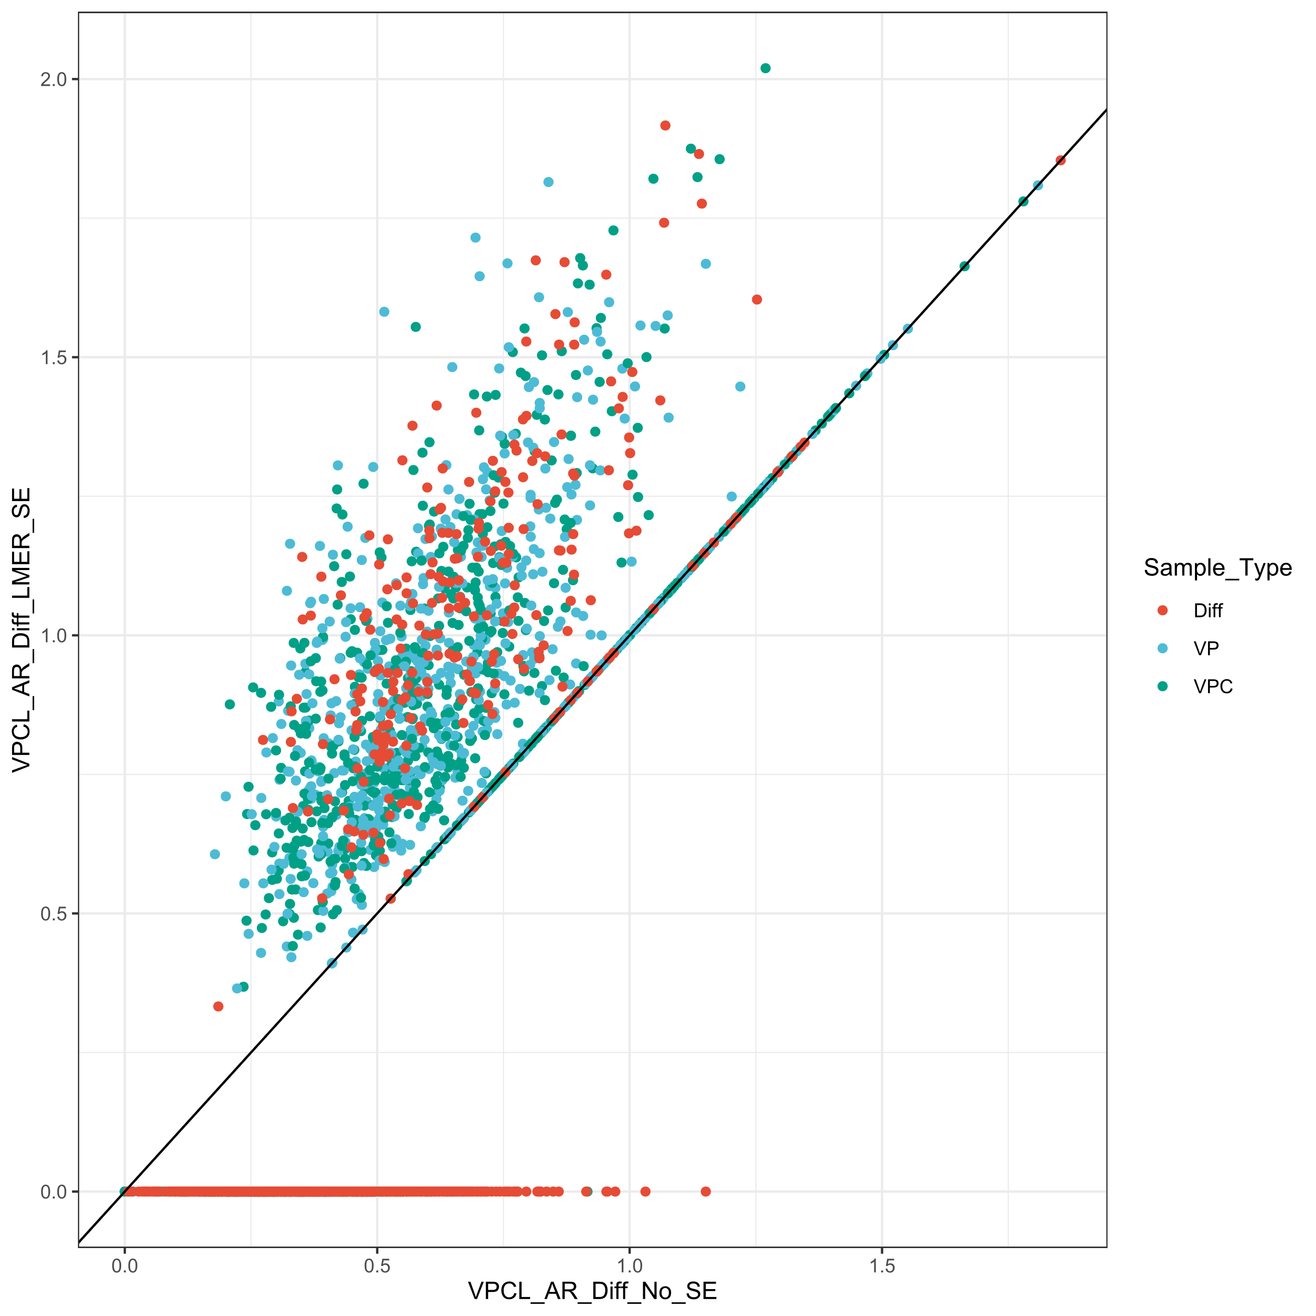
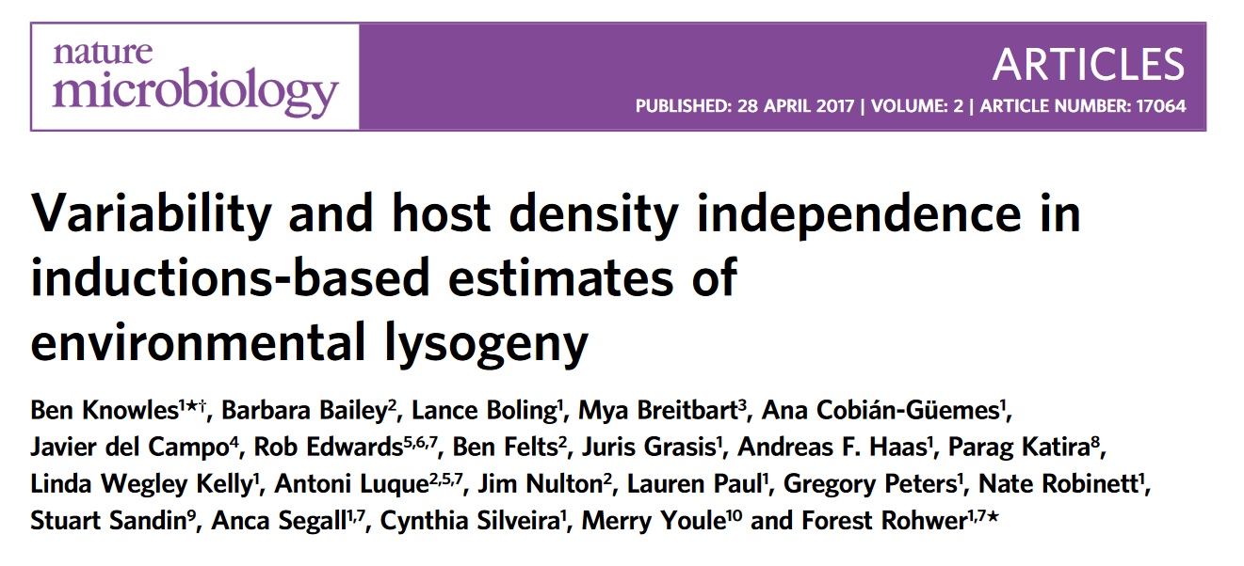

Slide 15
Conclusions
Lack of standardization in estimating viral production rates. Re-analysis?
VIPCAL-SE is more conservative.

Slide 17
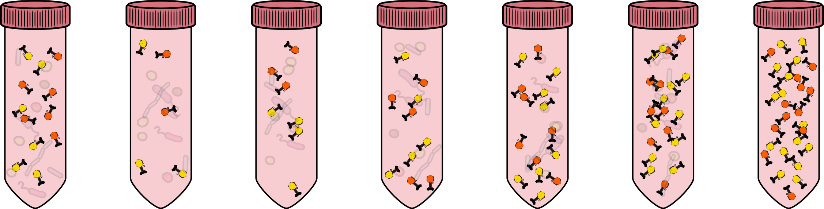
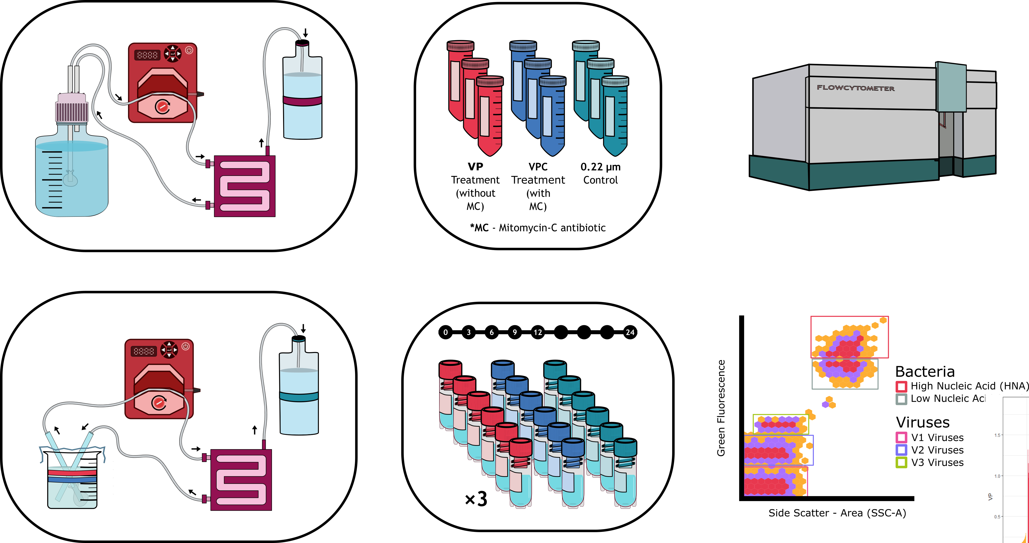
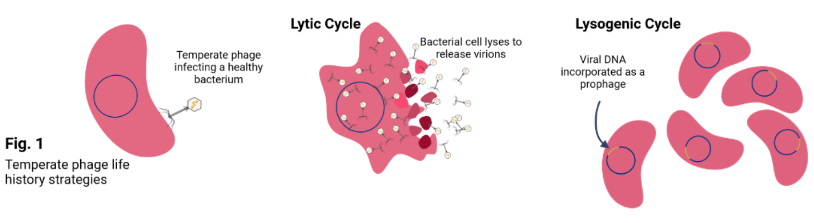
Viral Production/Reduction Assays
Seawater
T0
T3
T6
T9
T12
T24
Tangential Flow Filtration
Vira Production assays have been used to estimate viral production rates and also lysogeny.
Lysogeny and dependence on host abundance

Slide 18
Viral Production Assays
Lysogeny and dependence on host abundance
Vira Production assays have been used to estimate viral production rates and also lysogeny.

Slide 20
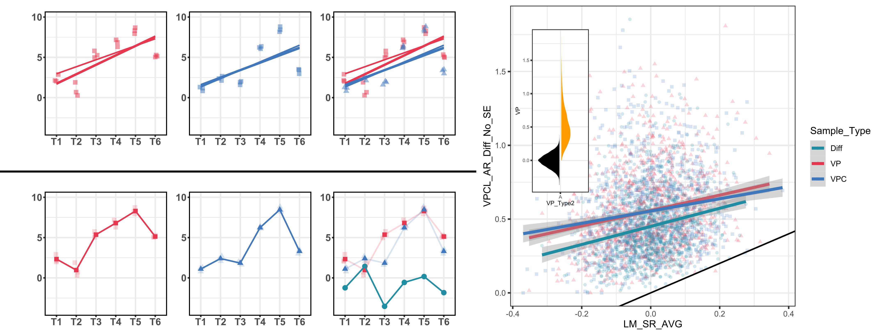
Lytic
Lytic +Lysogeny
Lysogeny
VP
VPC
Diff
Linear Method (LM)
VIPCAL Method (VPCL)
VIPCAL Method (VPCL)
Linear Method (LM)

Slide 21
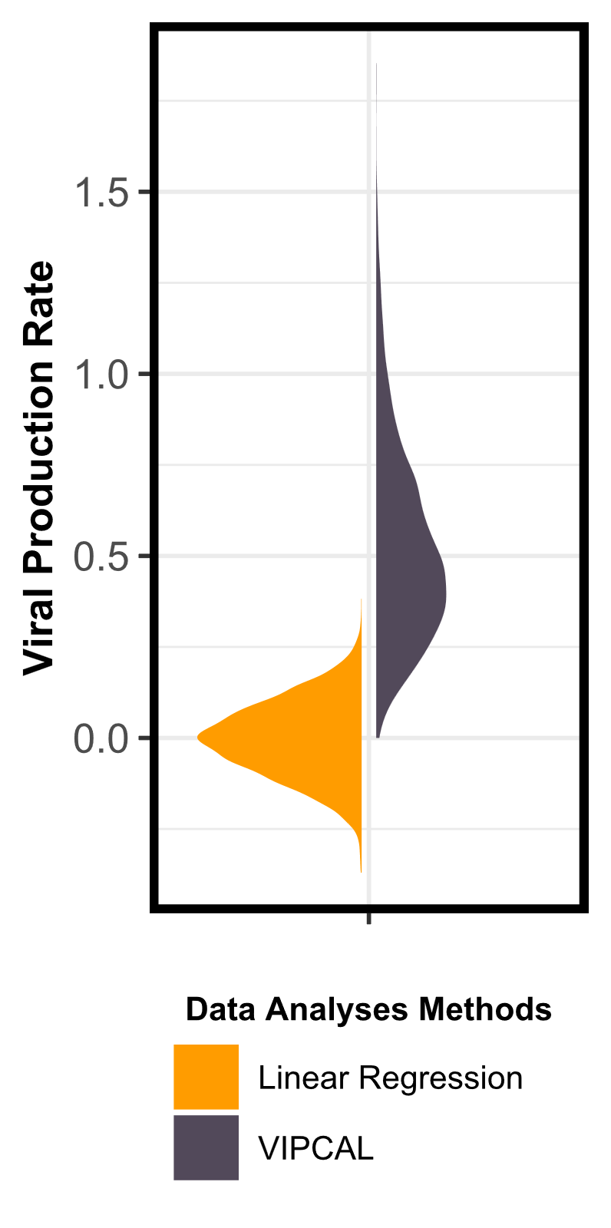
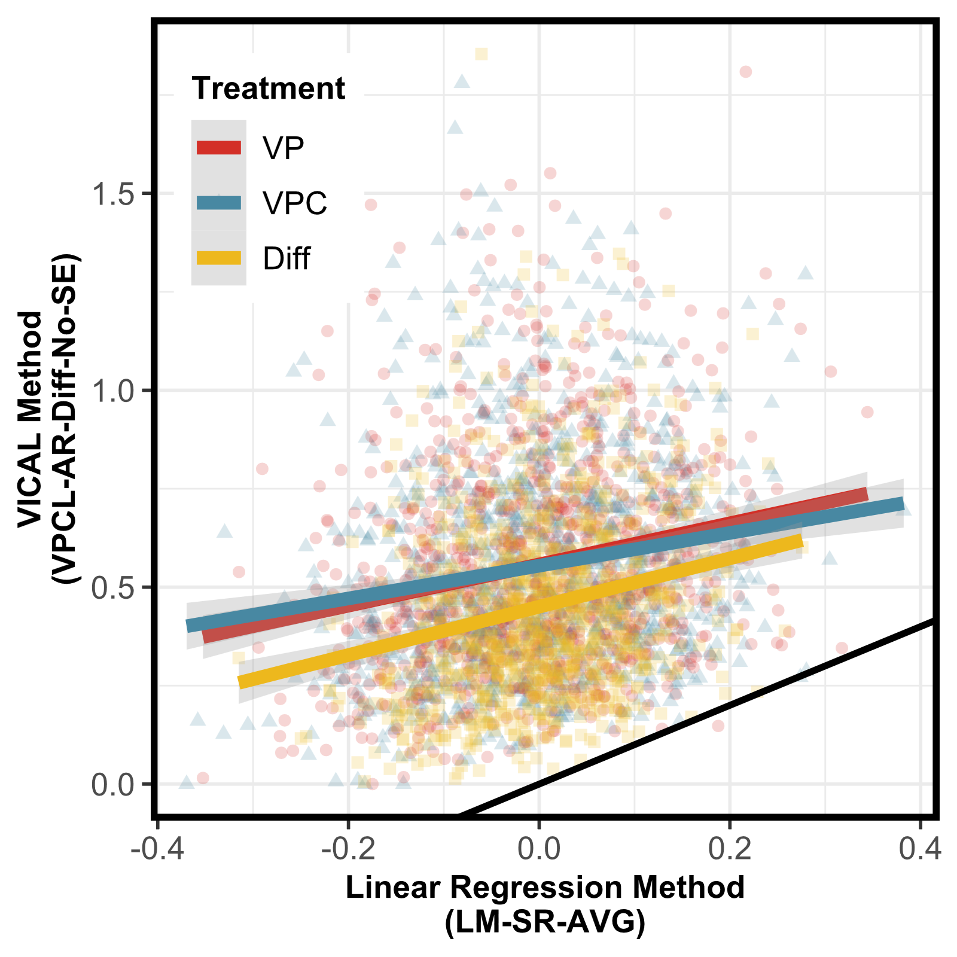

Slide 22
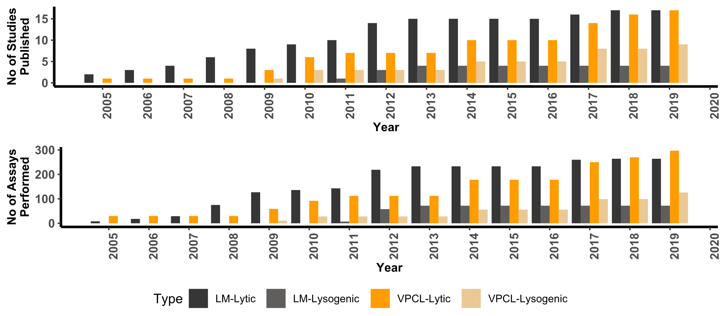

Slide 24
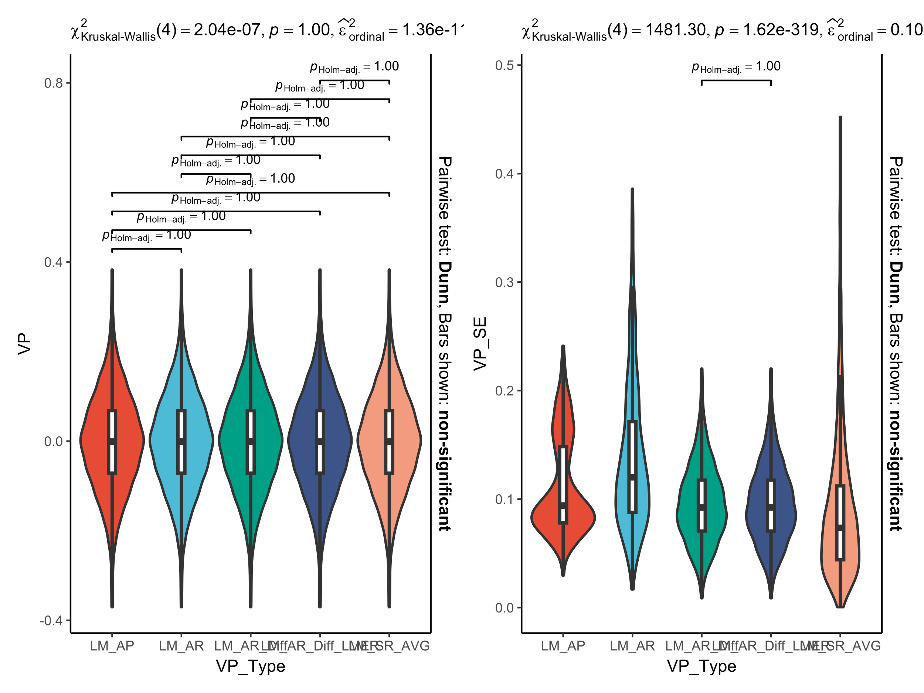

Slide 25
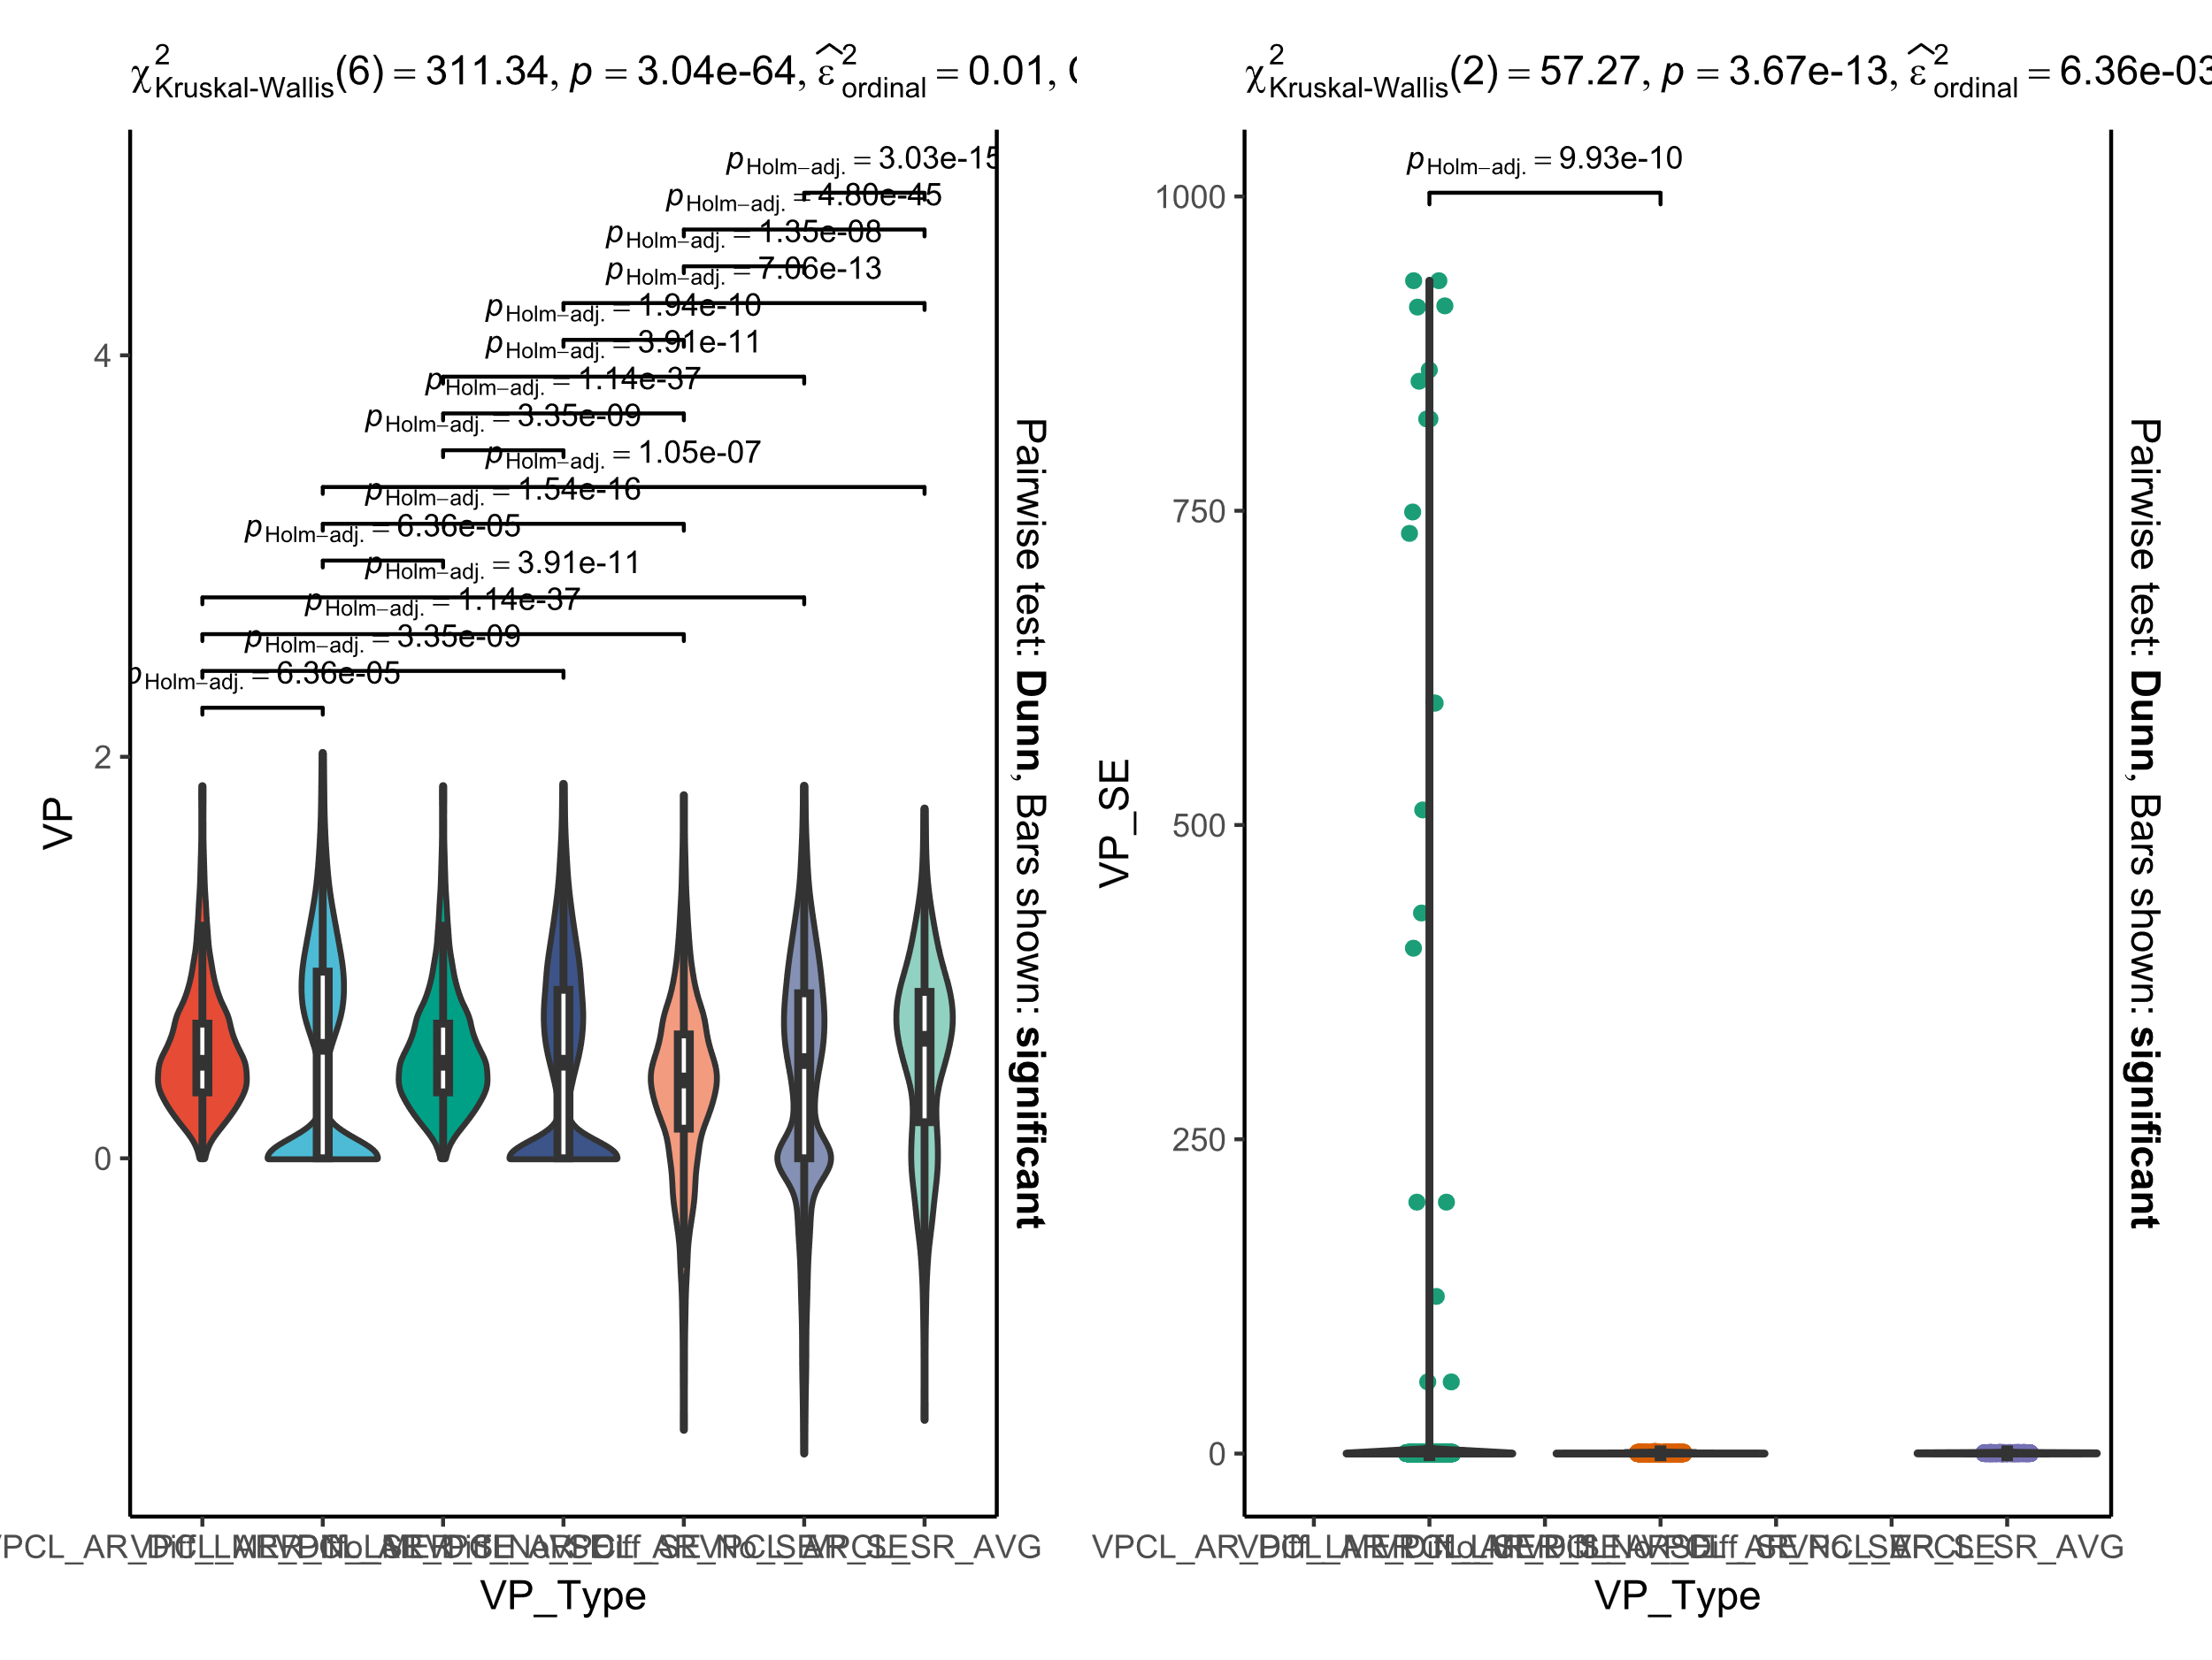

Slide 26

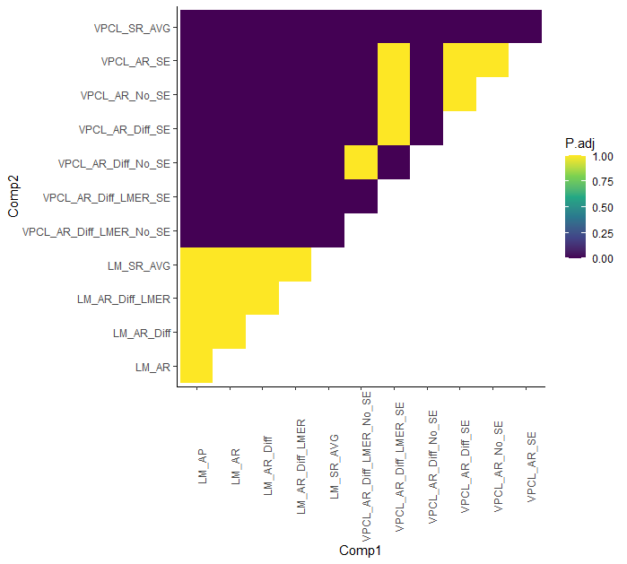


Slide 27
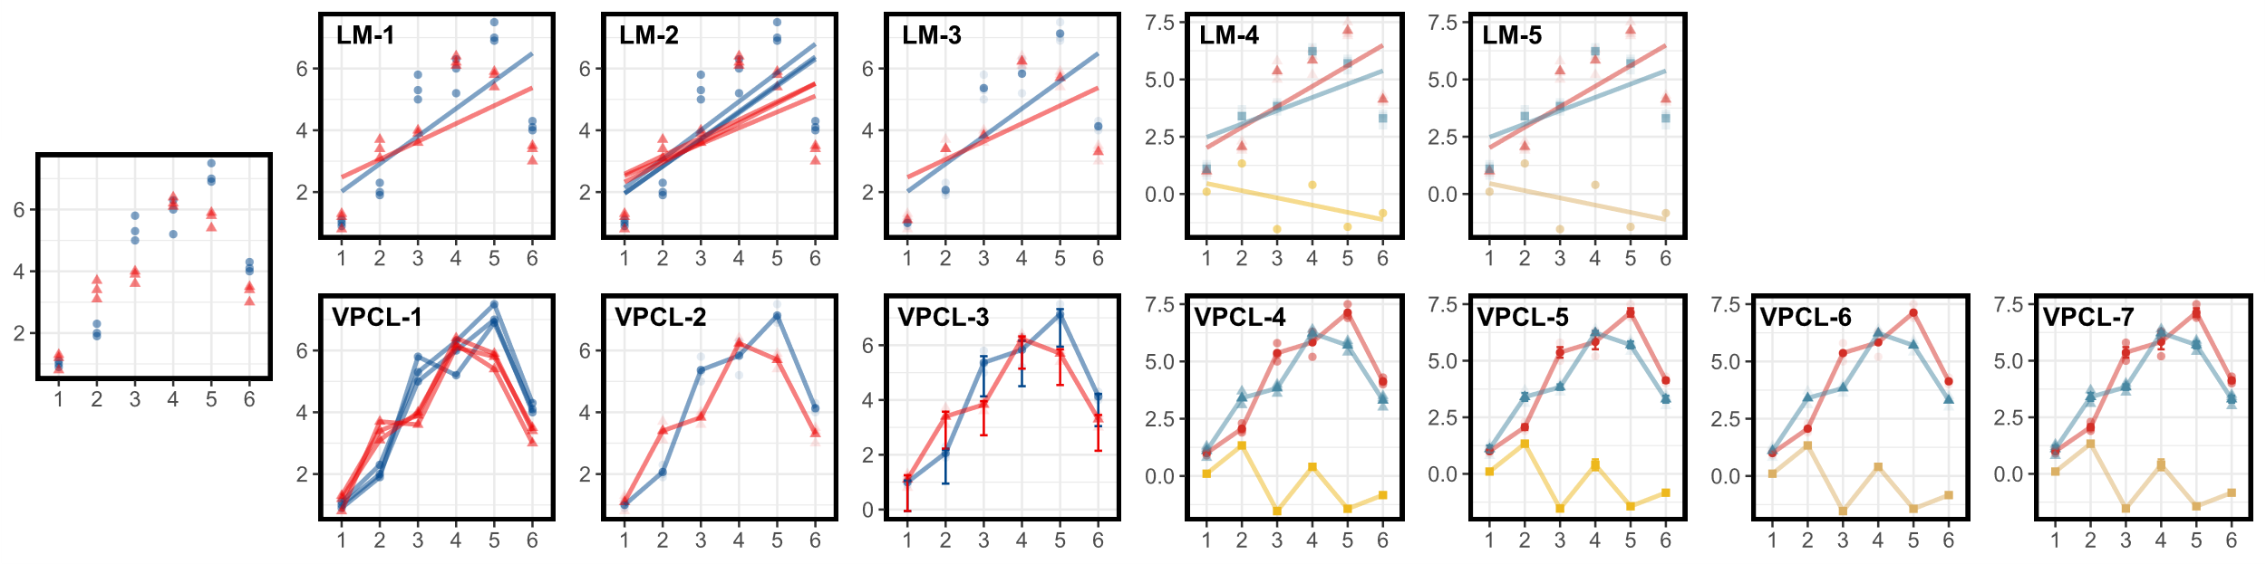

Slide 28
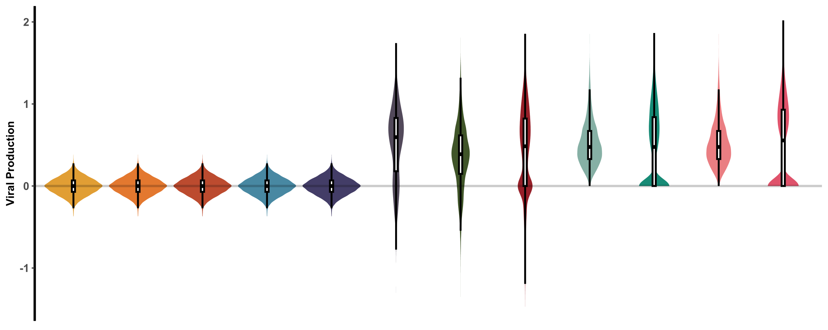

Slide 29
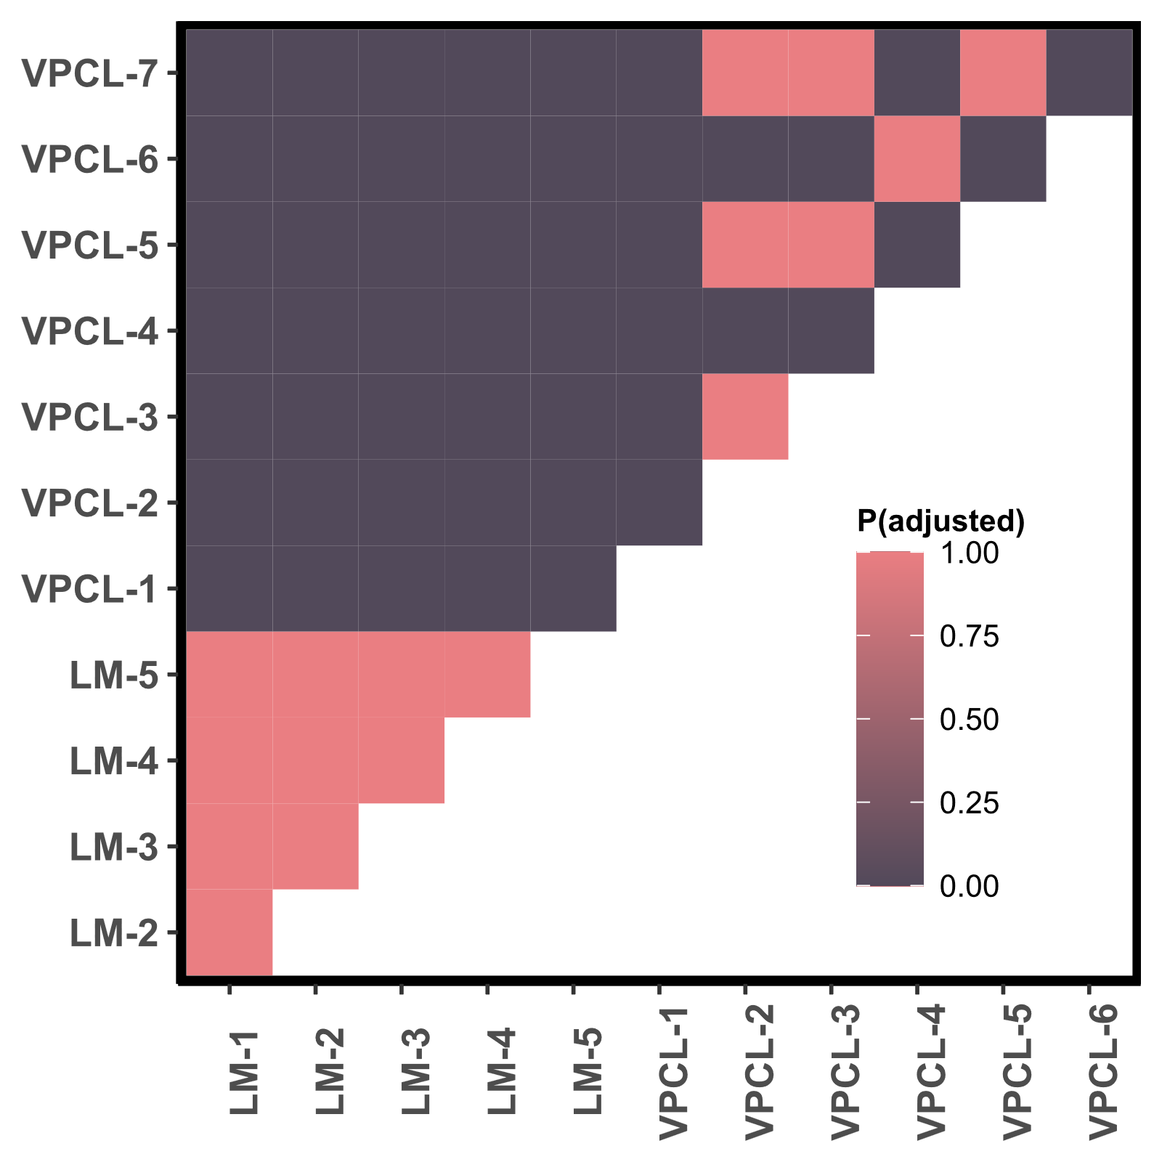
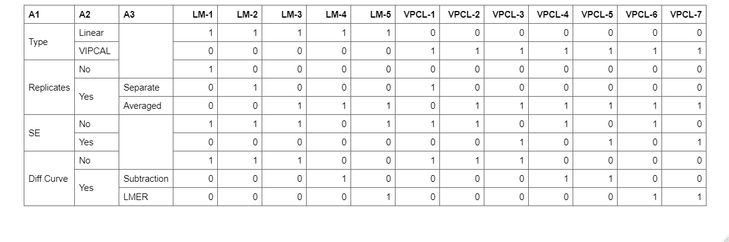

Slide 30
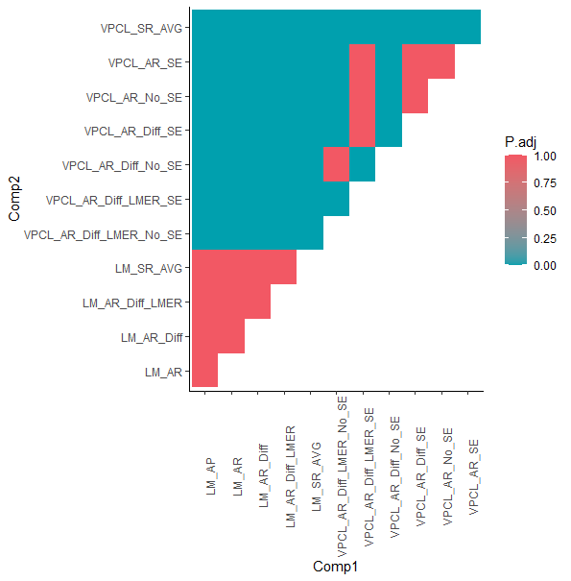
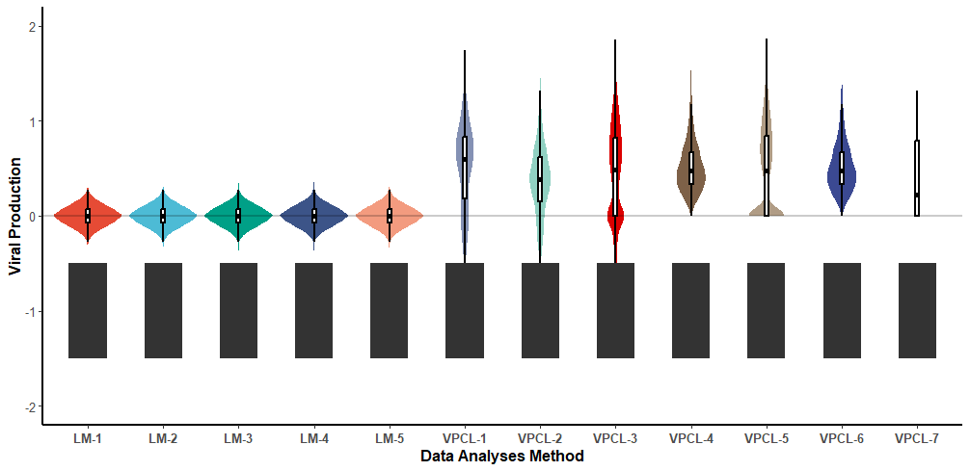
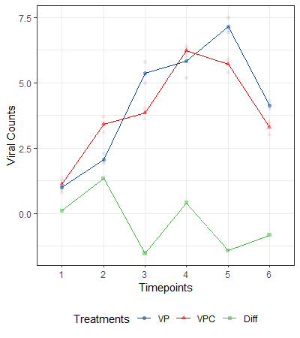
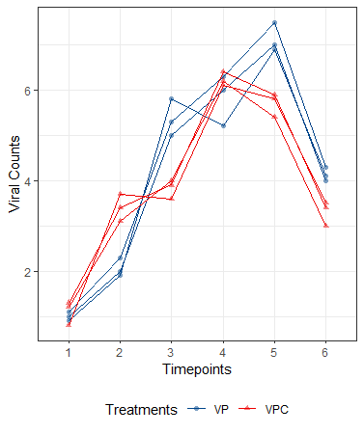
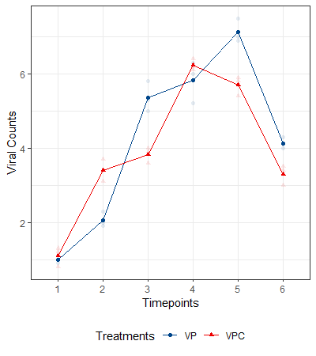
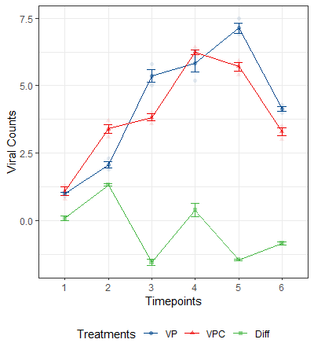
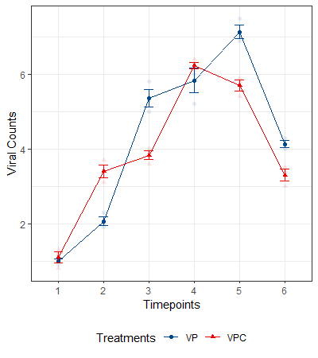
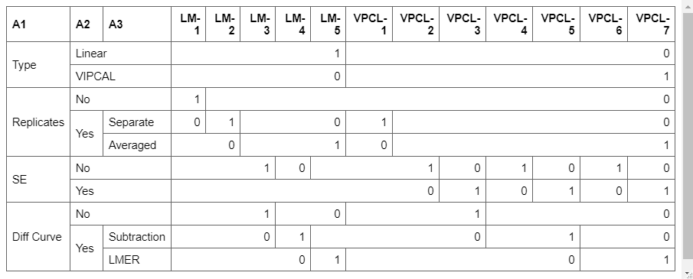

Slide 31
Comparison of LM-AP, VIPCAL and VIPCAL-SE. ggbetweenstats

Slide 32
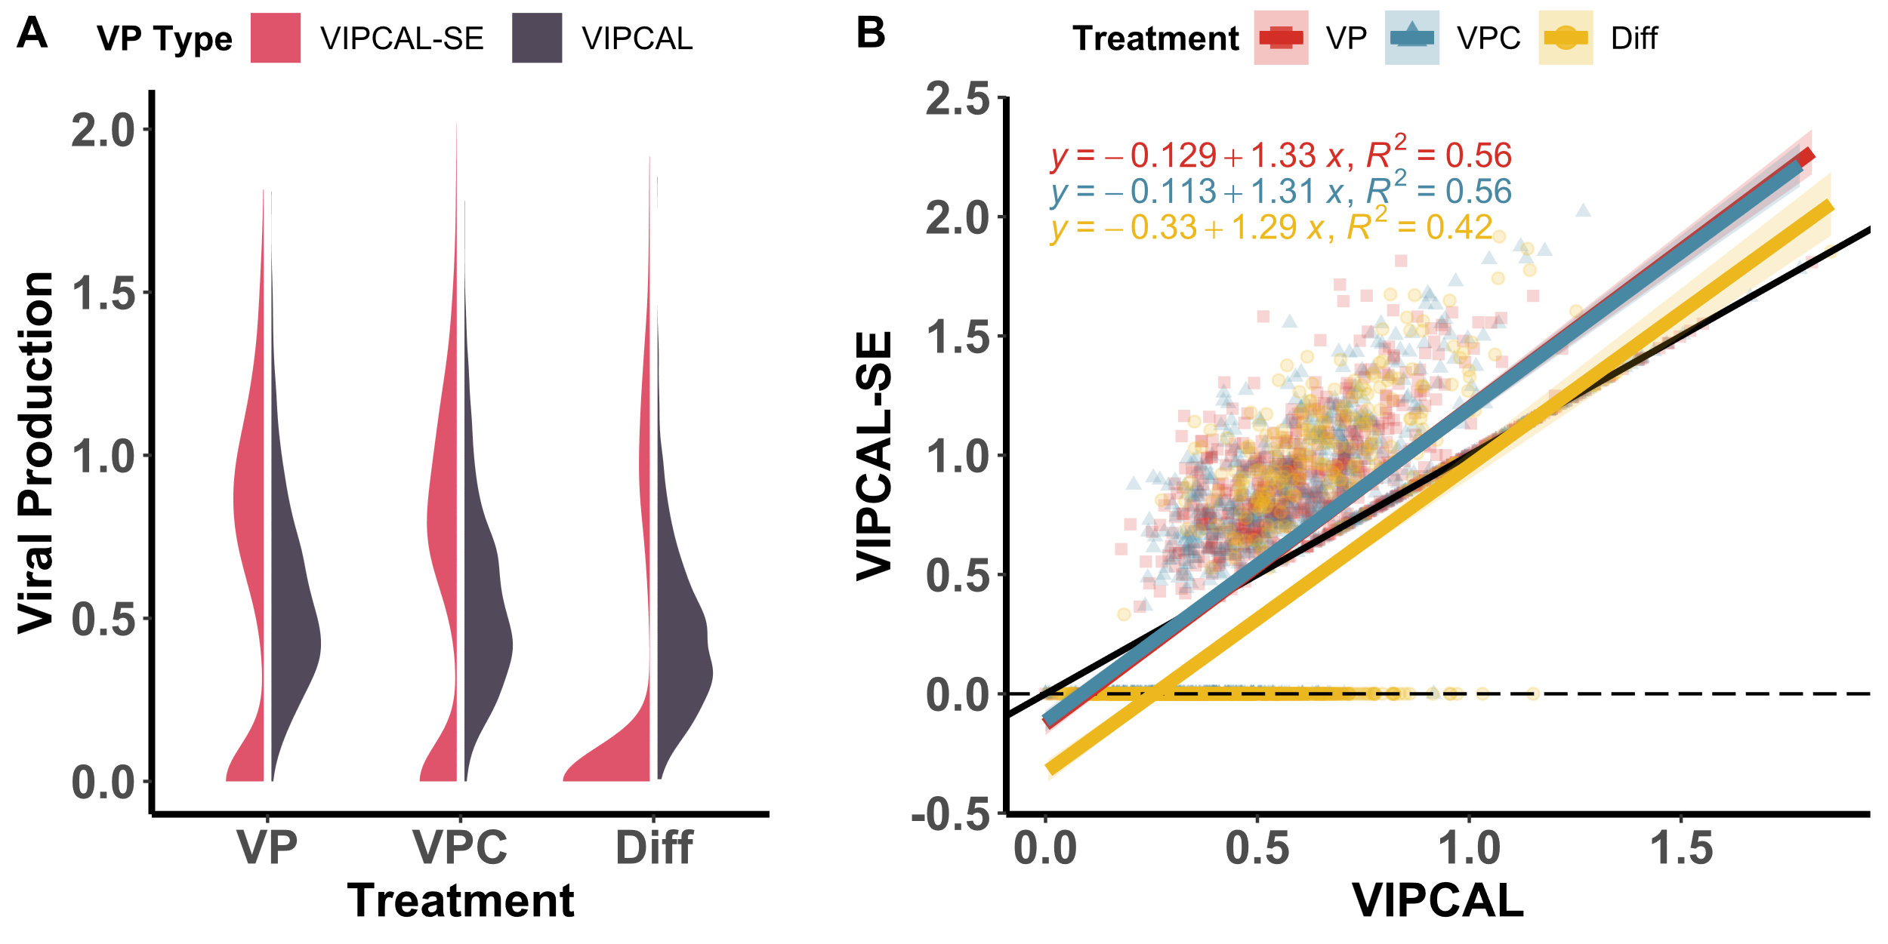
Kruskal wallis and dunn test here

Slide 33

Kruskal wallis and dunn test here

Slide 34
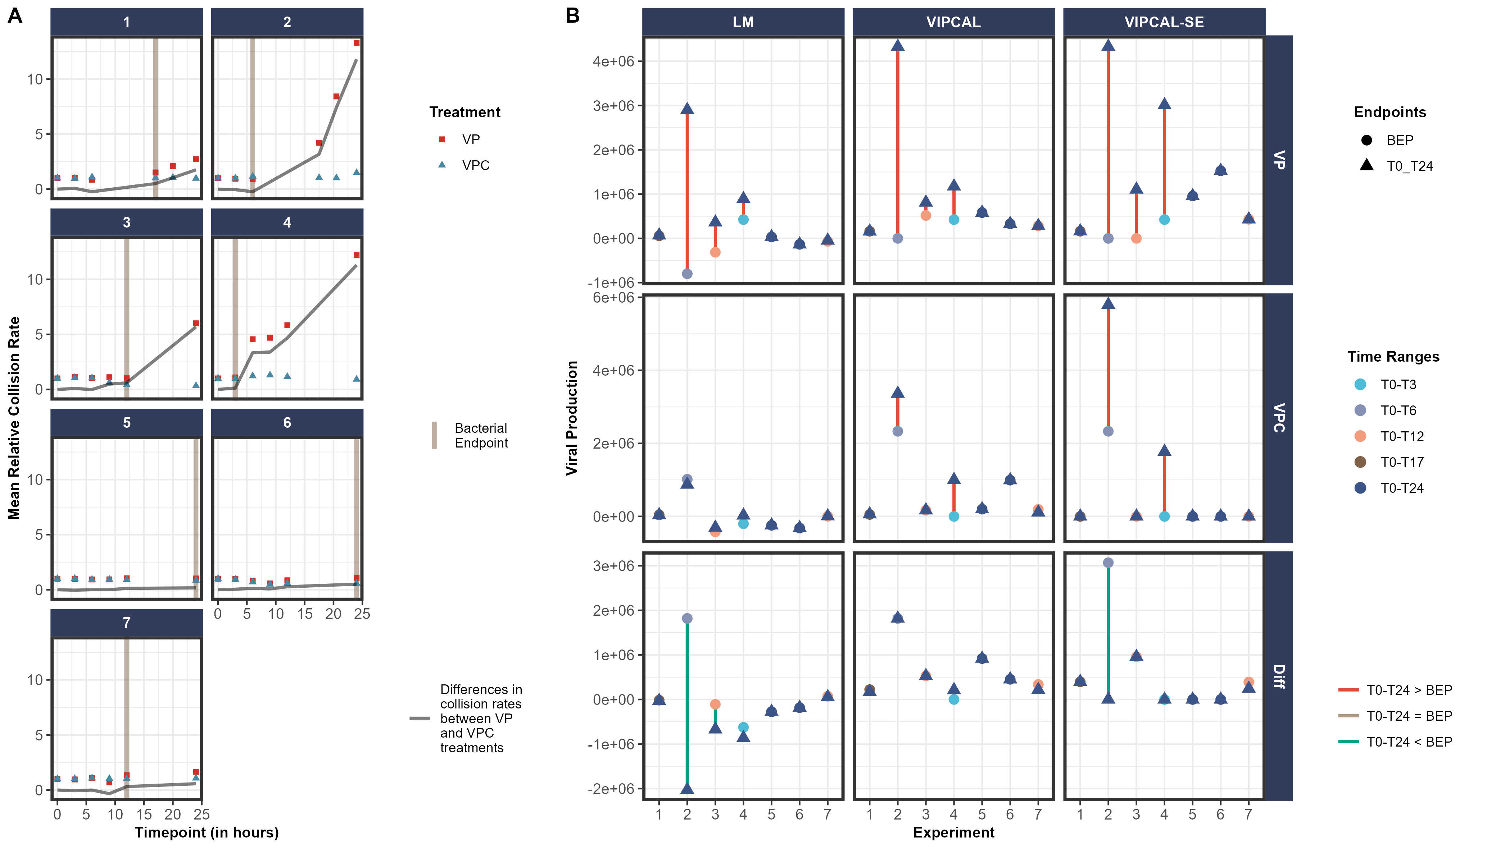
Compare means to see if diff between VP and VPC is significant

Slide 35
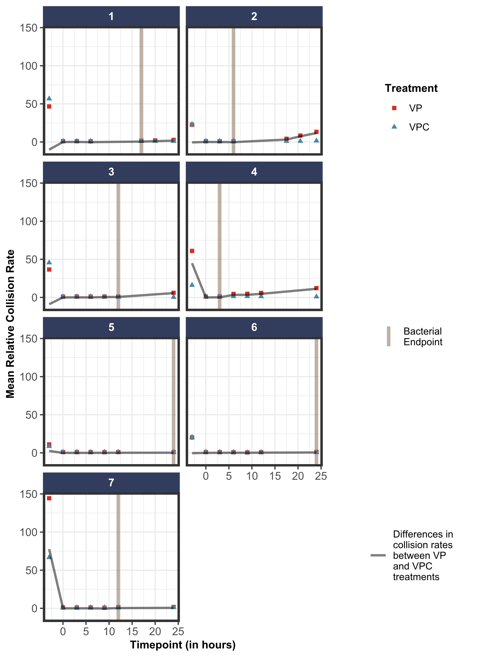

Slide 36
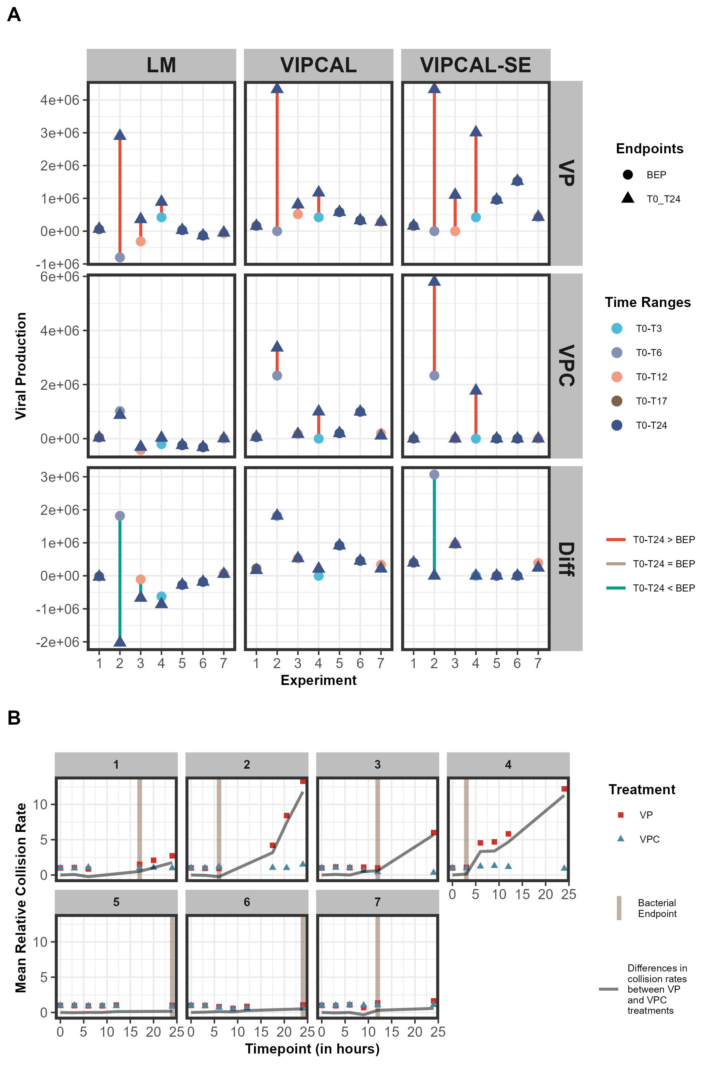

Slide 37
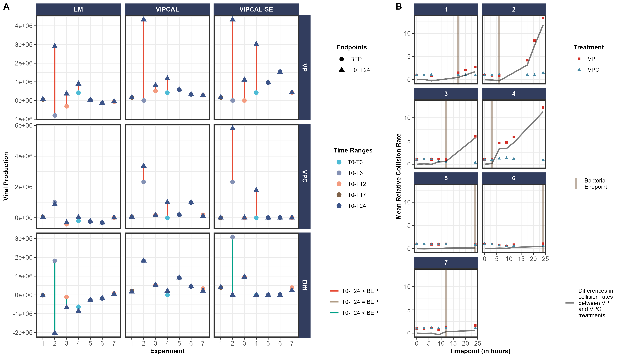

Slide 38
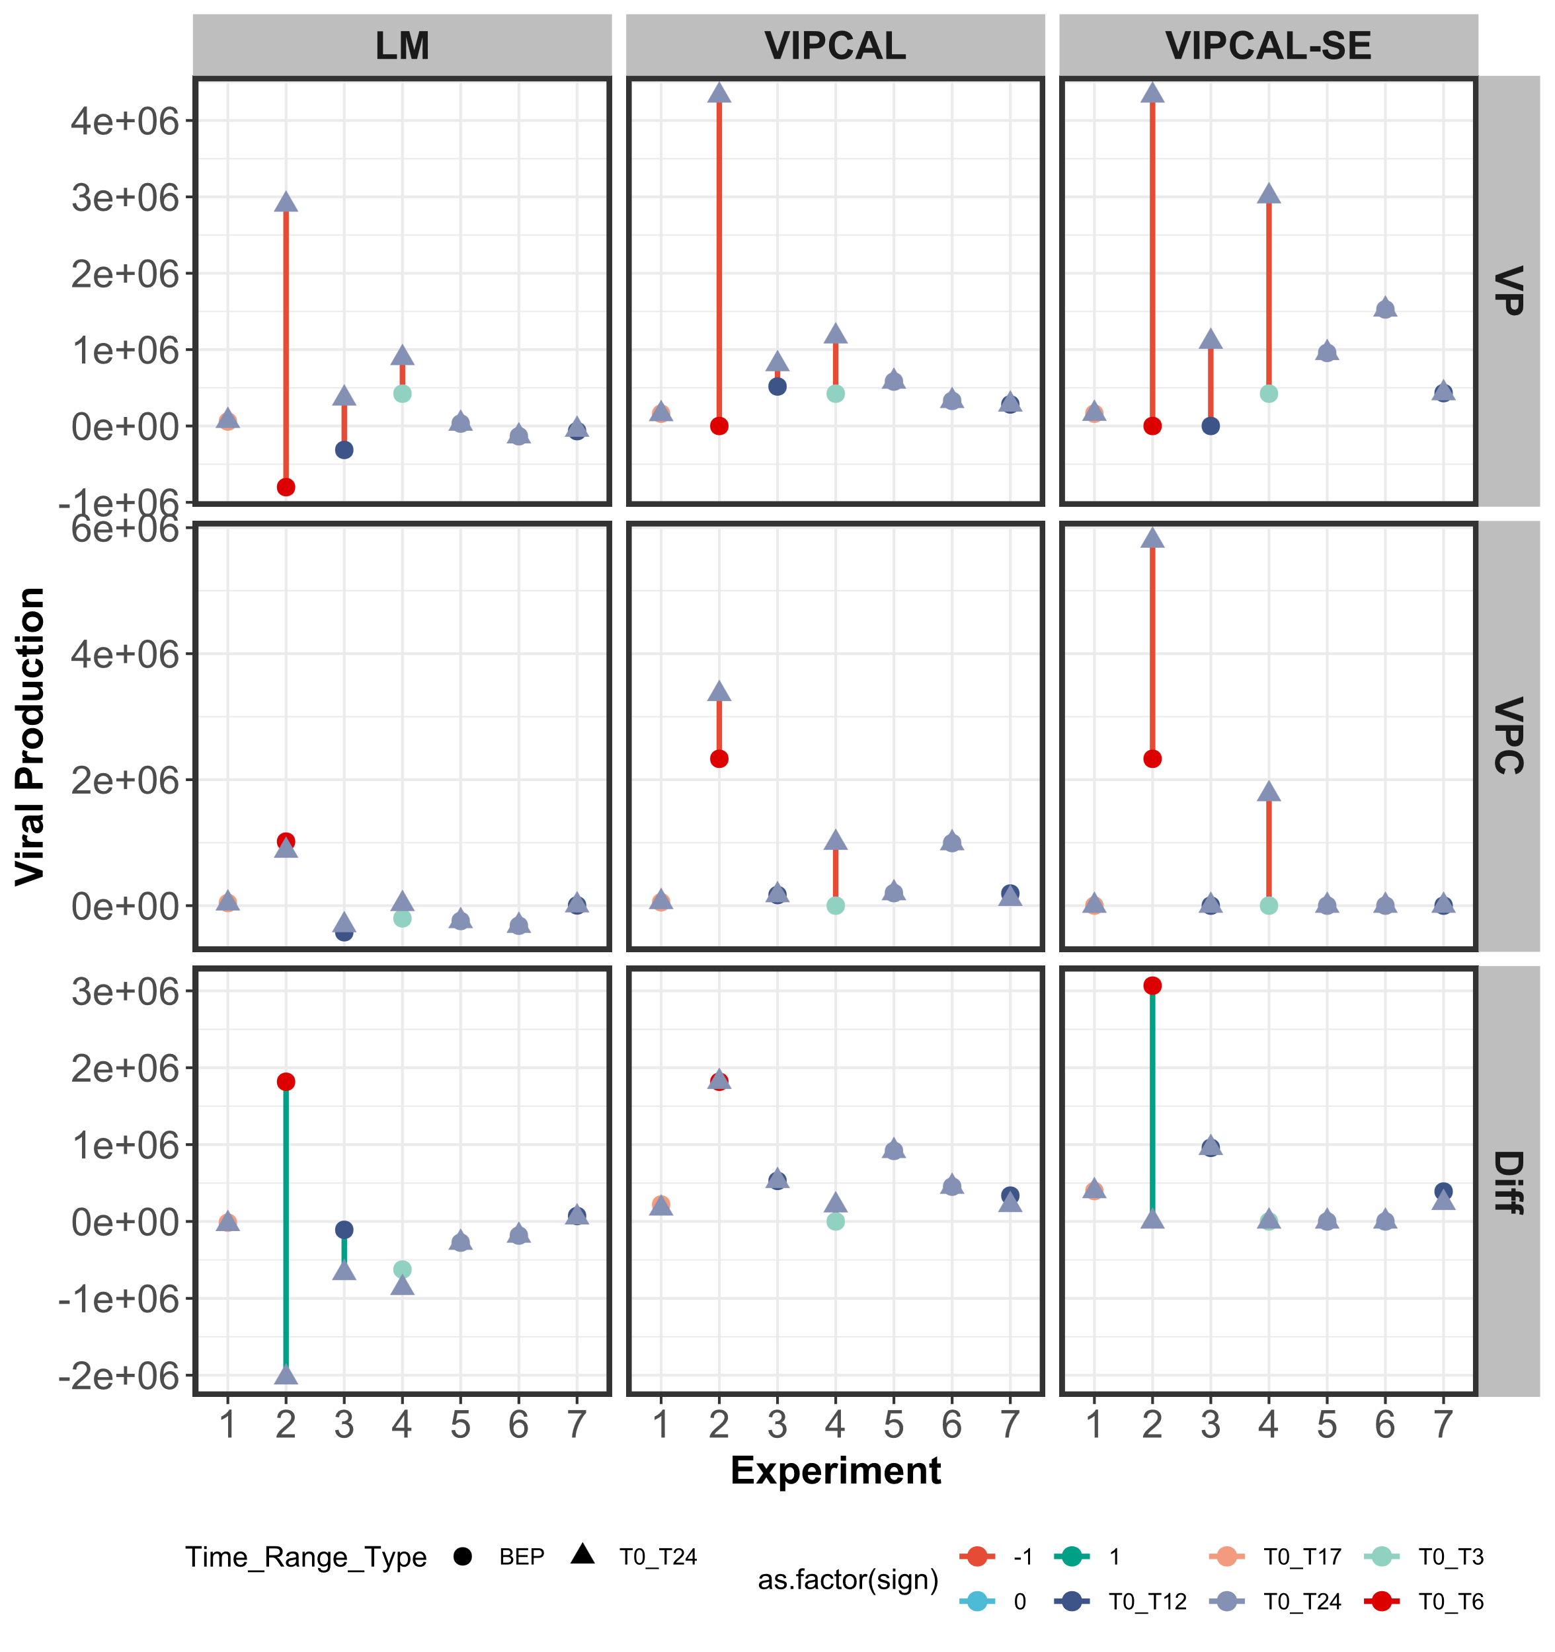

Slide 39
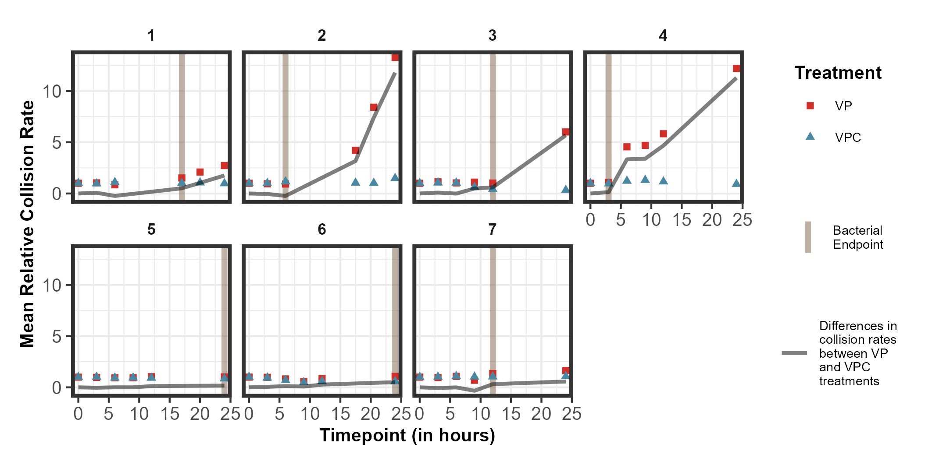

Slide 40
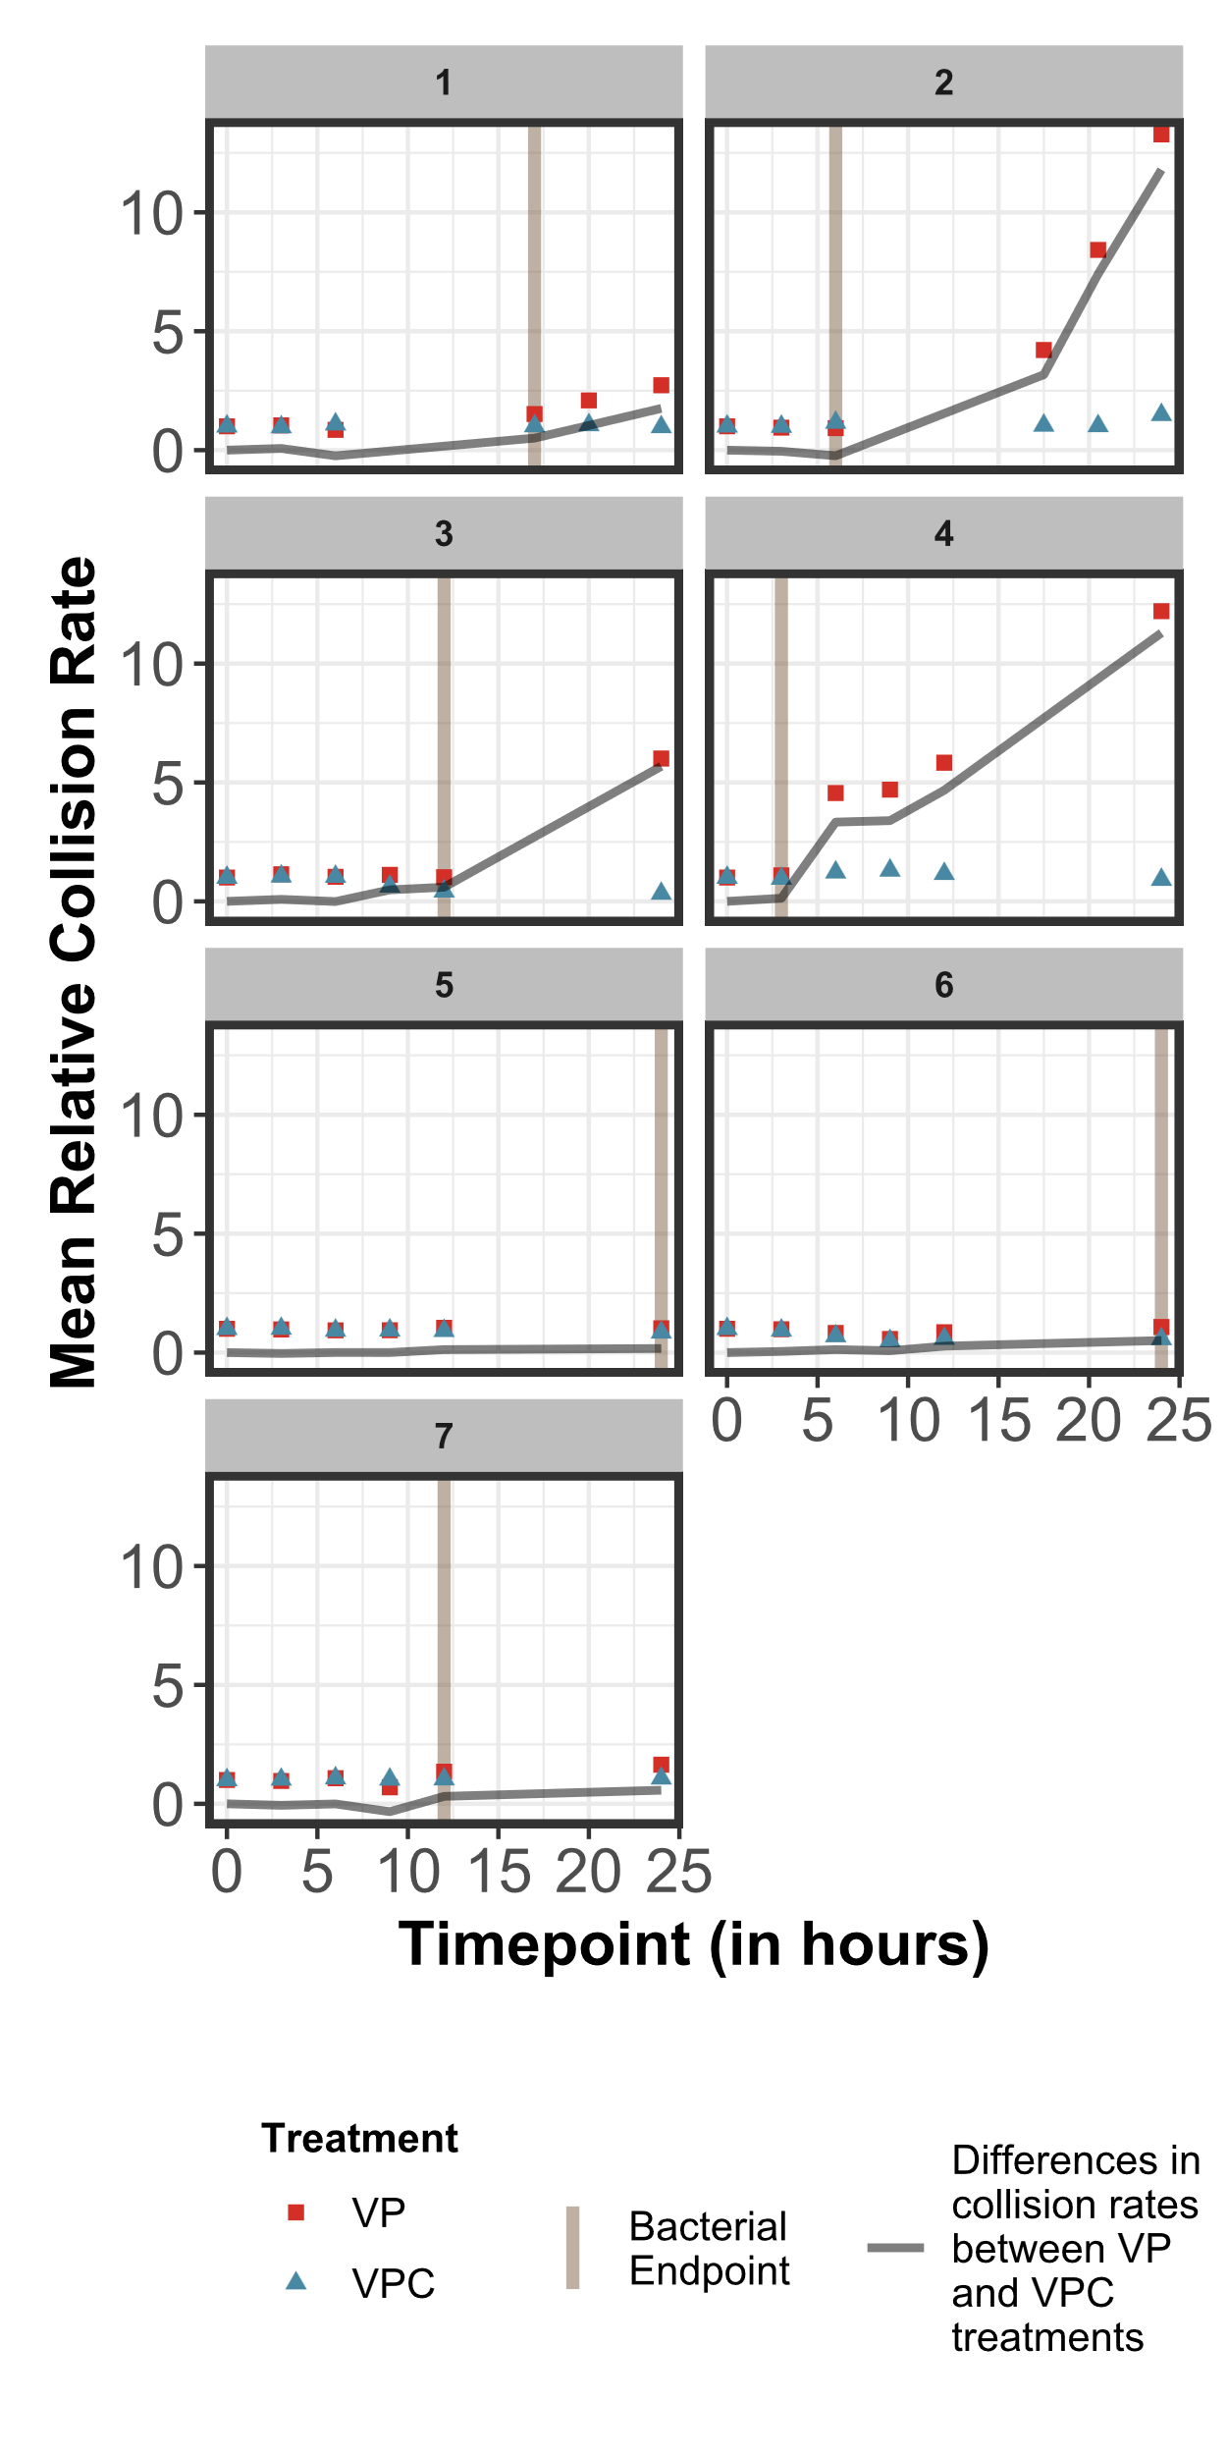
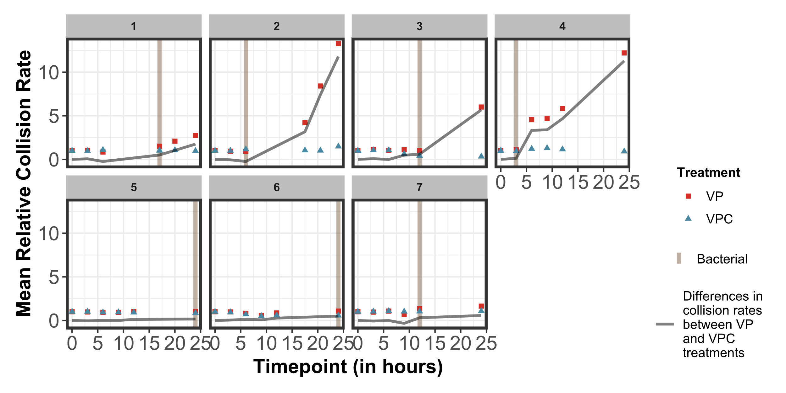

Slide 41
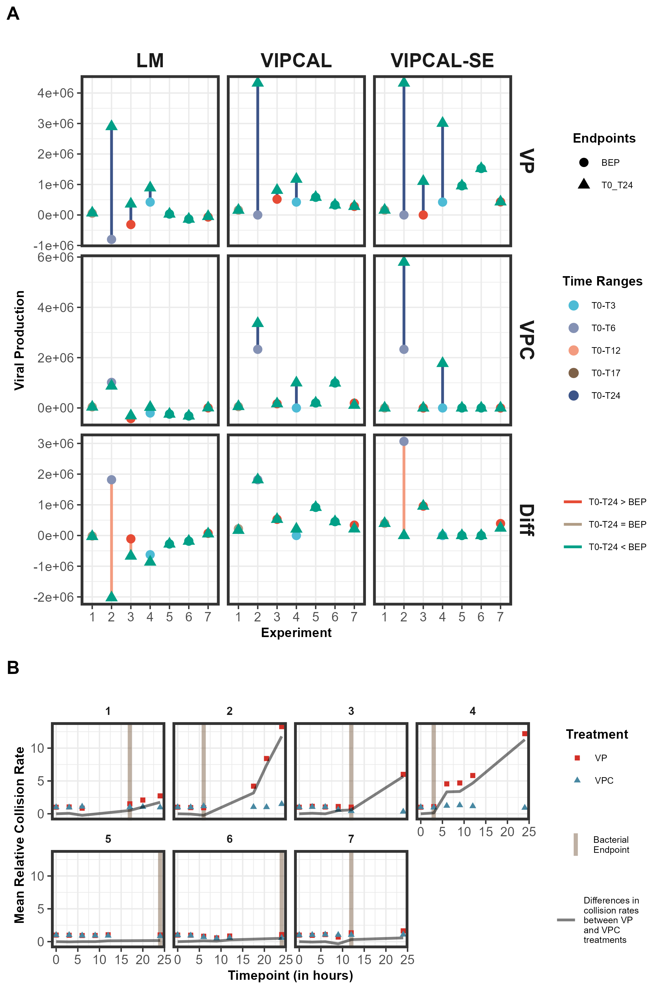

Slide 42
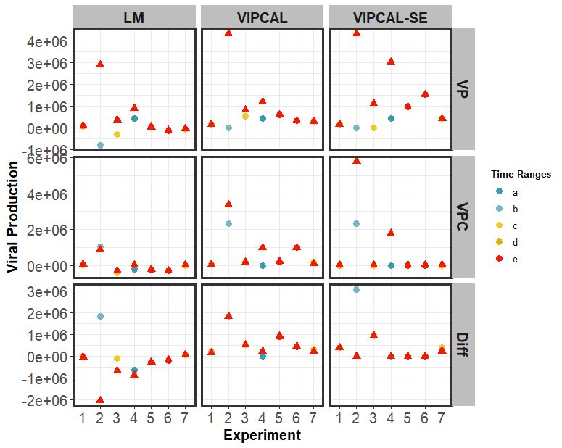

Slide 43
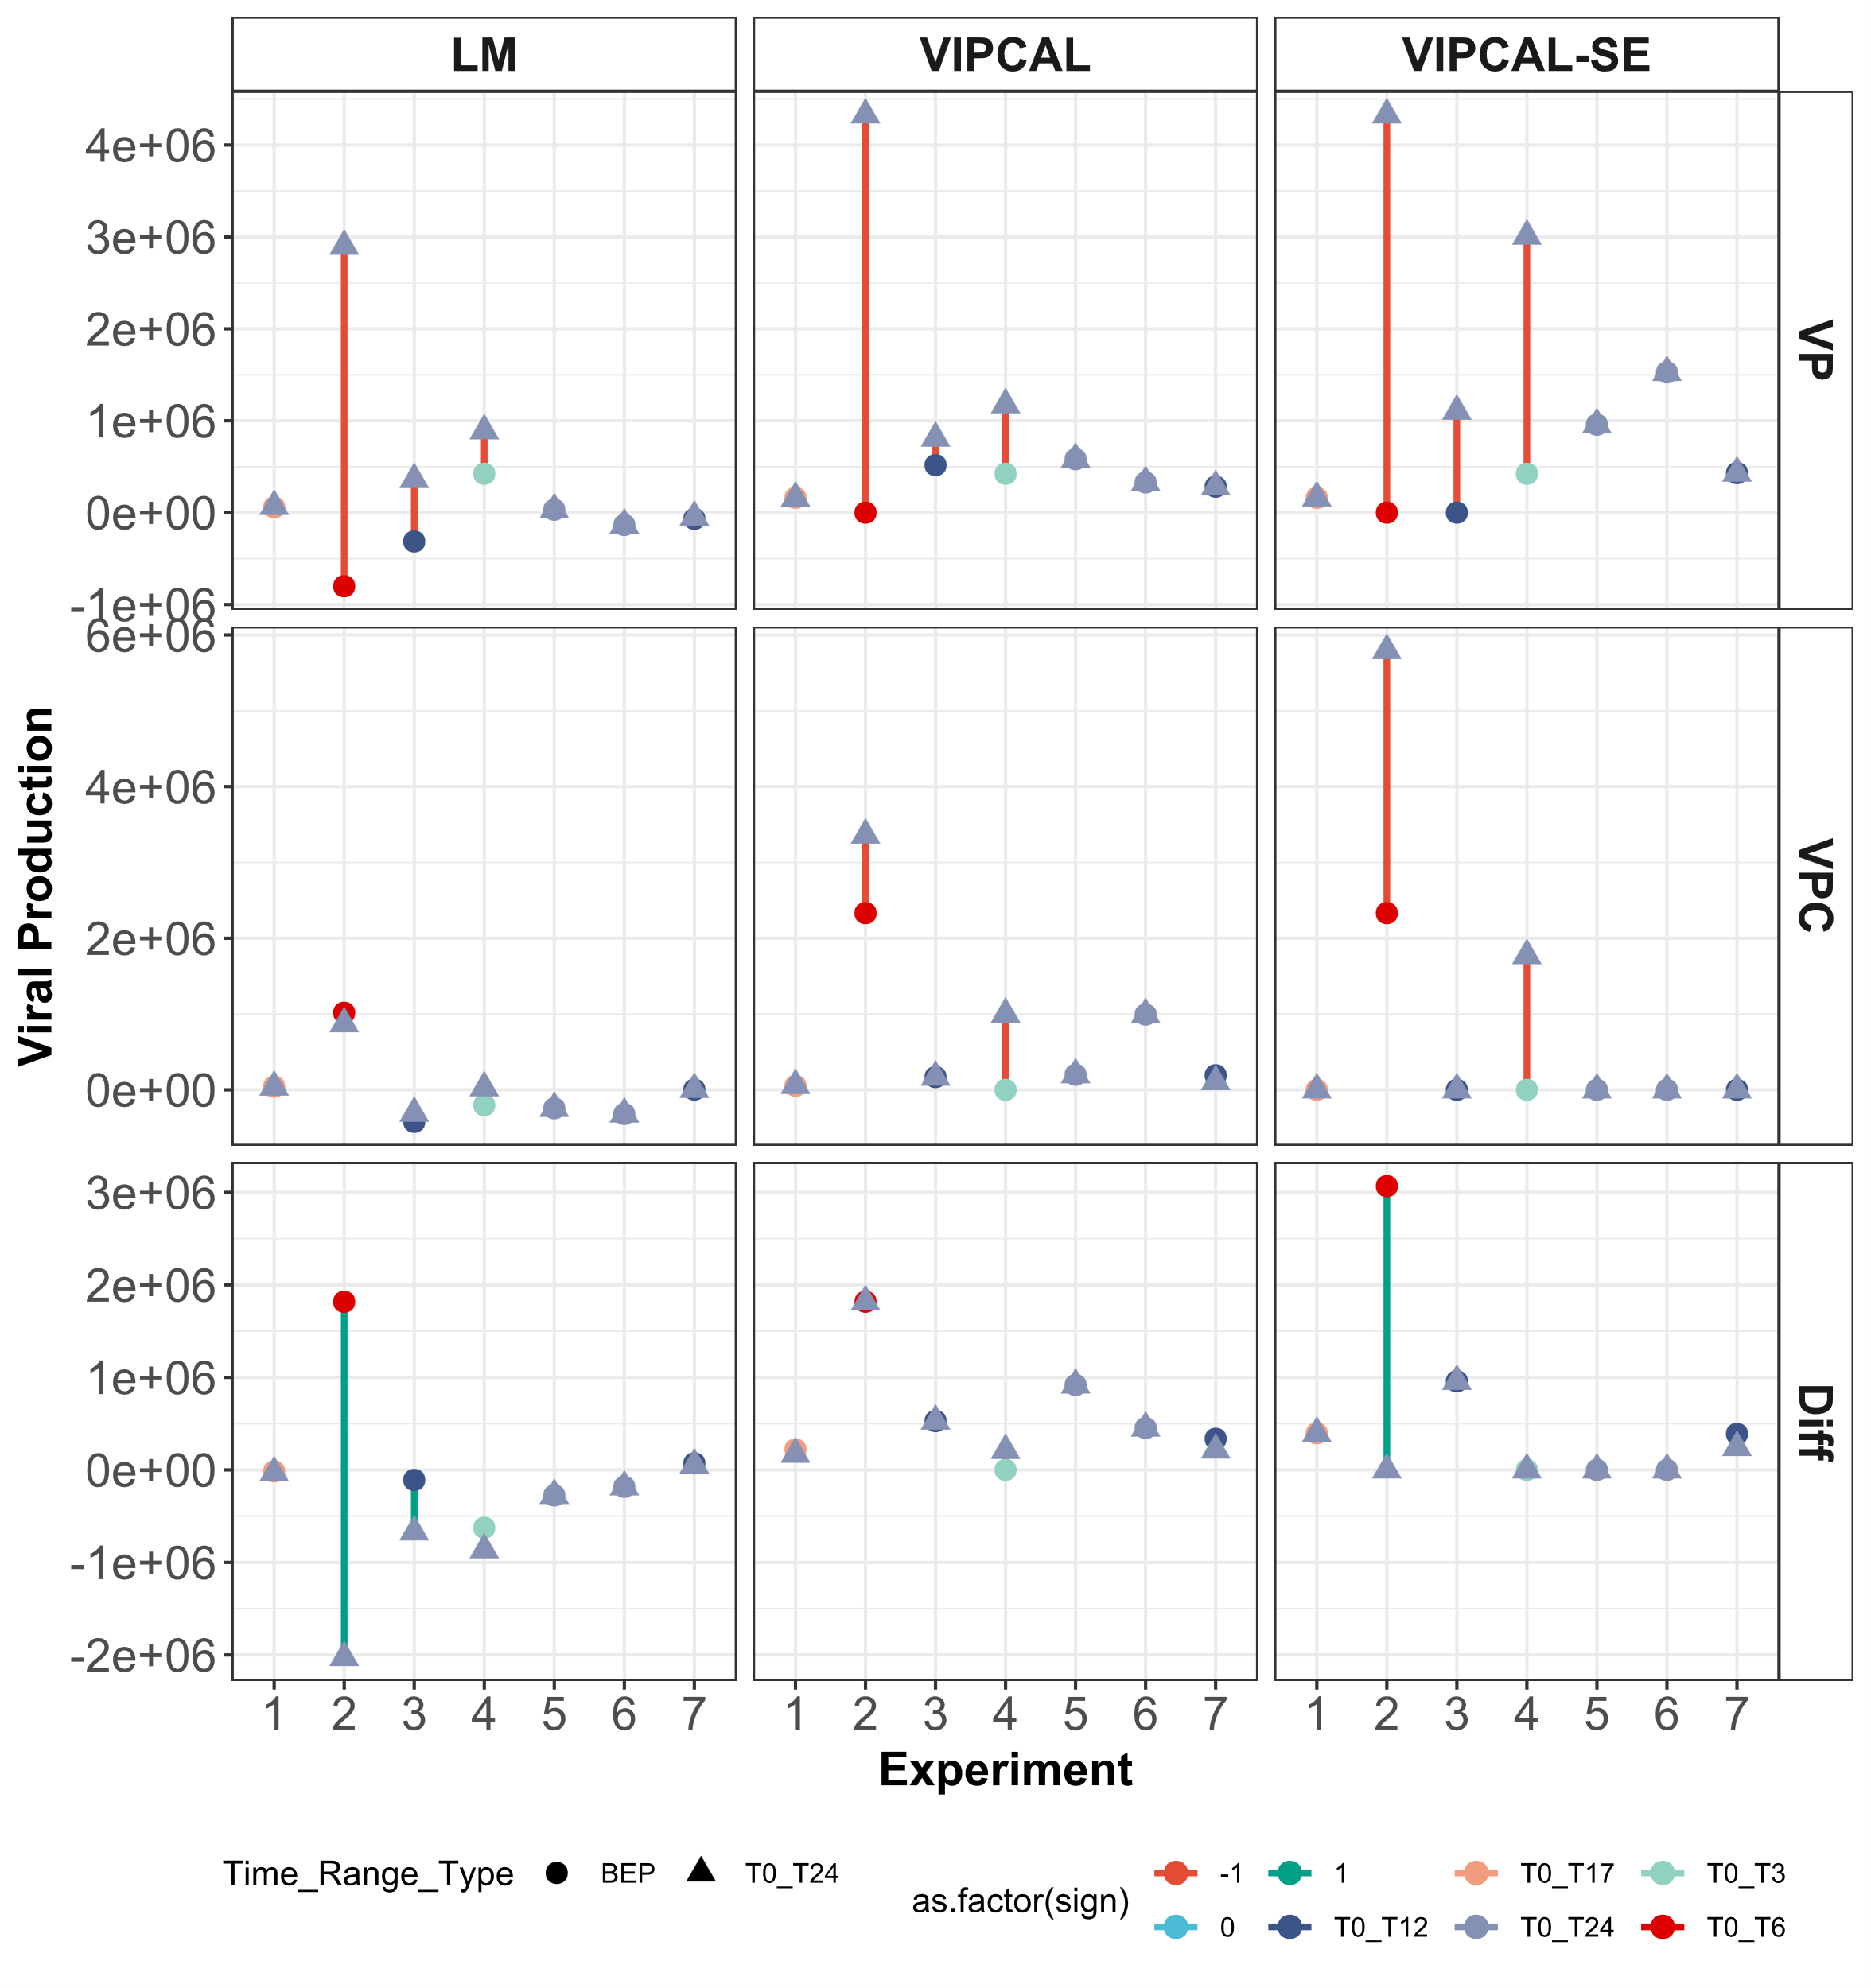


Slide 44


Slide 45


Slide 46




a
b
c
d
Viral Production
e
Time
f

Slide 47

a
b
c
d
Viral Production
e
Time
f

Slide 48

Figure 1. Viral Reduction Assay: Principles, assumptions, and data analyses methods.
a. Viral reduction assays are employed to estimate viral production rates, viral-mediated microbial mortality, extent of lysogeny, viral-turnover rates, along with organic carbon and nitrogen release due to viral lysis. Briefly, virus-free seawater is generated using 30 KDa polyethersulfone (PES) tangential filtration flow (TFF) system. Viral reduction is perfomed using 0.22 µm PES TFF

Slide 49


Slide 50


Slide 51



a
Viral Production
b
c
Time
d

Slide 52

Kruskal wallis and dunn test here

Slide 53



Kruskal wallis and dunn test here

Slide 54
Scenarios

